Slide 1
The Path to Aperture Synthesis
SKANZ 2012
Auckland, 15 Feb 2012
Ron Ekers
CSIRO, Australia
Notes:
Radio astronomers routinely use aperture synthesis images. The underlying concepts have a rich history involving discovery, and sociology, and some incredible individuals.

Slide 2
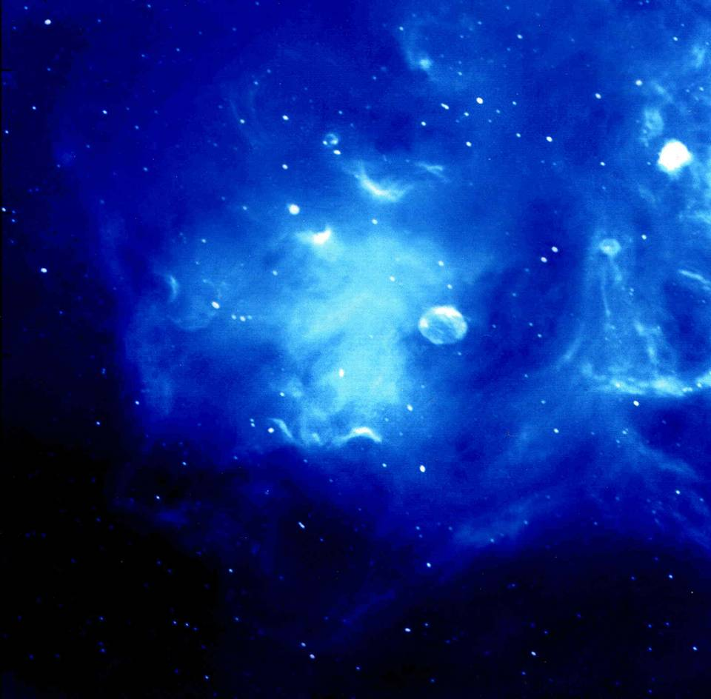
Today we use Aperture Synthesis Images routinely
But the path to developing the underlying concepts has a rich history involving discovery, sociology, and some incredible individuals
Radio Image of
Ionised Hydrogen in Cyg X
CGPS (Penticton)
2
Notes:
2

Slide 3
Summary
History of the development of aperture synthesis
  Emphasis on the UK and Australian developments
The continuing computer challenge
US and the VLA
“Modern” algorithm developments
Notes:
Added for SKANZ 2012

Slide 4
Deep History
1891: Michelson defines fringe visibility
  Gives the Fourier equations but doesn't call it a Fourier transform
Stereo X-ray imaging
1912: X-ray diffraction in crystals
1930: van Cittert-Zernike theorem
  Now considered the basis of Fourier synthesis imaging
  Played no role in the early radio astronomy developments but appears in the literature after Born & Wolf Principles of Optics (1960)
1930-38: 3D X-ray tomography
  Analogue devices to do back projection summation
Notes:
4

Slide 5
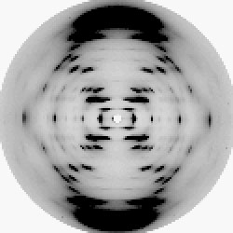
X-ray Crystallography
1912
  X-ray diffraction in crystals
1936
  Lipson & Beevers strips
  Fourier synthesis calculations routine in X-ray crystallography
1939
  Bragg's X-ray crystallography group flourishing at the Cavendish Laboratory
    2D Fourier analysis
    phase problem,
5
Notes:
5

Slide 6
Ratcliffe and Pawsey
Cambridge and Sydney
1935
  Pawsey PhD with Ratcliffe at Cambridge (ionosphere)
1940
  Pawsey joins CSIRO Radiophysics Laboratory in Sydney but maintains strong links with Ratcliffe in Cambridge
1945
  Pawsey investigates radio emission from the sun
1946-1949
  Pawsey introduces Bracewell to duality of physical and mathematical descriptions following Ratcliffe's style
  Bracewell sent from Sydney to work with Ratcliffe
6
Notes:
6
Abbreviated version, Bracewell combined
Removed: Ratcliffe ≡ Pawsey + Bowen for non Aus audiences

Slide 7
Ryle and the Cavendish
1945
  Ryle joins Cavendish laboratory
    uses WWII radar technology for radio astronomy
1946
  Ryle and Vonberg (Nature 158, 339-340 (Aug 1946)
    interferometric measurement of sunspots
  introduces the use of a Michelson interferometer to measure the angular diameter of the source of the radiation and references Michelson
7
Notes:
7
detected circular polarization
(probably independent but already seen by Appleton, Hey and Martyn)
Quote from Ryle’s Nobel Prize autobiography
...both Ratcliffe and Bragg gave enormous support and encouragement. Braggs work on Xray crystallography involved techniques very similar to those we were developing for "aperture sysnthesis”

Slide 8
Technology 1946
8
1946
  Punched cards for Fourier series summation
  Sea interferometer at Dover Heights
    26 Jan 1946
  Michelson interferometers in Cambridge
1949
  EDSAC I programmed by Wilkes could just do a 1D transform
    15 hrs for a 38 point transform for every 4min of data
Notes:
8

Slide 9
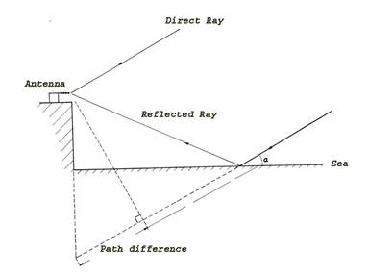
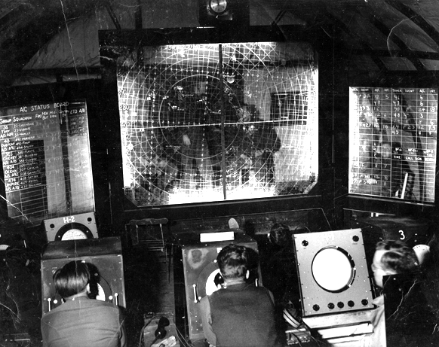
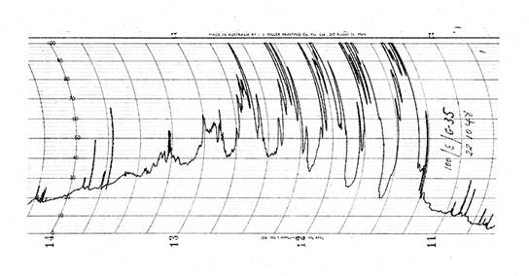
Cliff Interferometer - 1948
Bolton, Stanley and Slee
  100MHz Yagi
Loyds mirror
Notes:
At the end of May 1948, an ex-Army gun-laying radar trailer containing four 100Mhz Yagis, a
new 100MHz receiver, recorders, chronometers, and weather recording equipment were
shipped to New Zealand. This equipment was then moved to a site called ‘Pakiri Hill’ about
10km from a small fishing village called Leigh, about 70km north-west of Aukland. At this site
they obtained about 30 nights of observations of Cygnus-A and in mid-July five observations
of Taurus-A. A large number of observations were necessary to reduce the noise in the
sidereal time of the interference minima caused by irregular diffraction. One important
discovery that was made during these observations was that the observed amplitude
variations were of atmospheric origin and were not inherent in the source itself. Spacedaerial
observations between Leigh and Dover Heights showed almost complete correlation
between solar bursts at the two sites, but no correlation between source variations. At the
end of August 1948, the equipment was moved to a new site in New Zealand near Phia,
about 30 km north of Aukland. Over a three-week period, data was collected on four sources,
Cygnus-A, Taurus-A, Centaurus-A and Virgo-A.

Slide 10
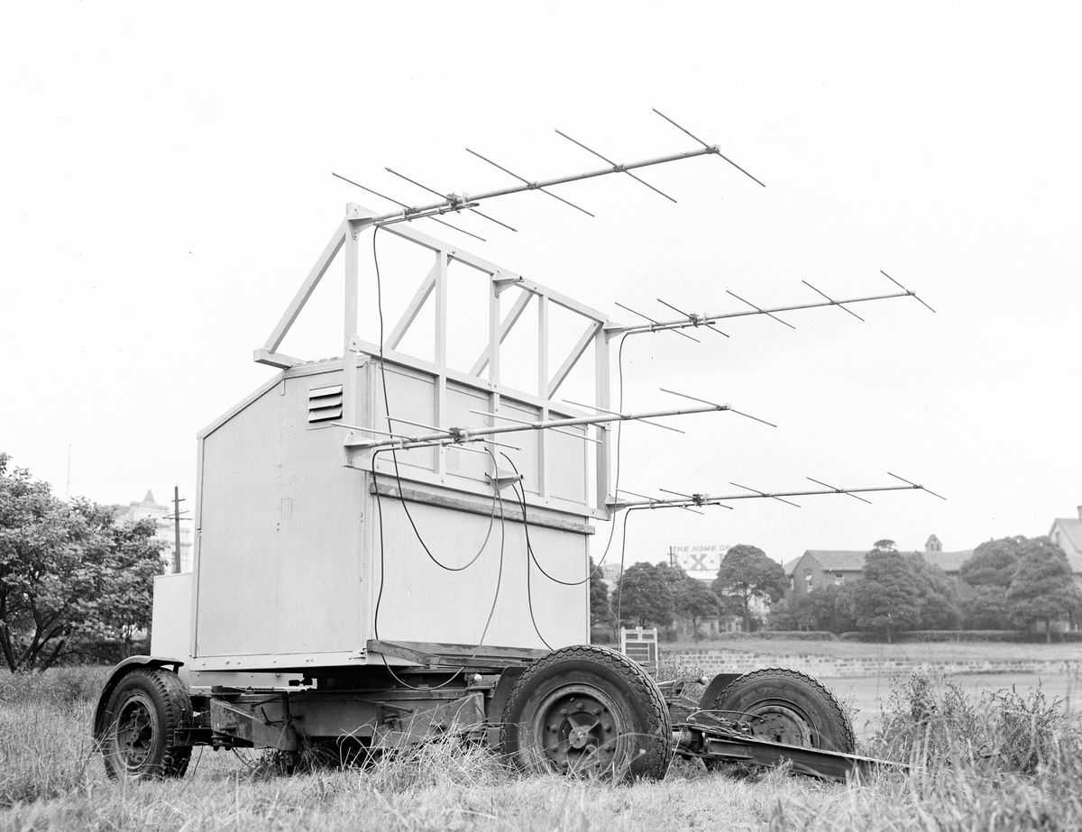

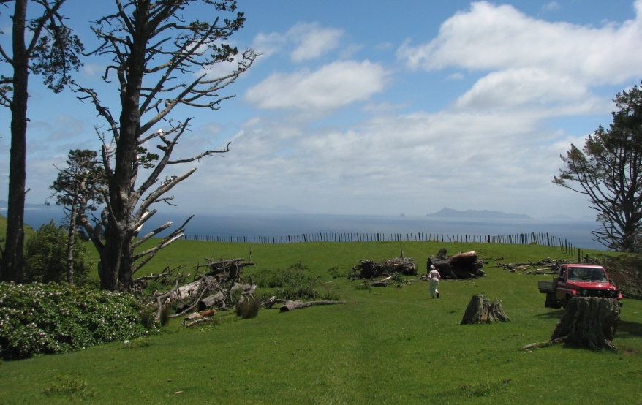
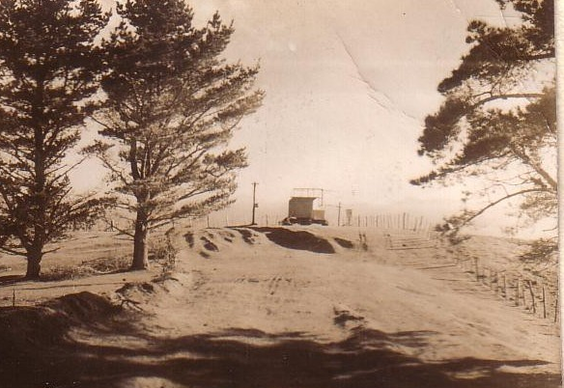
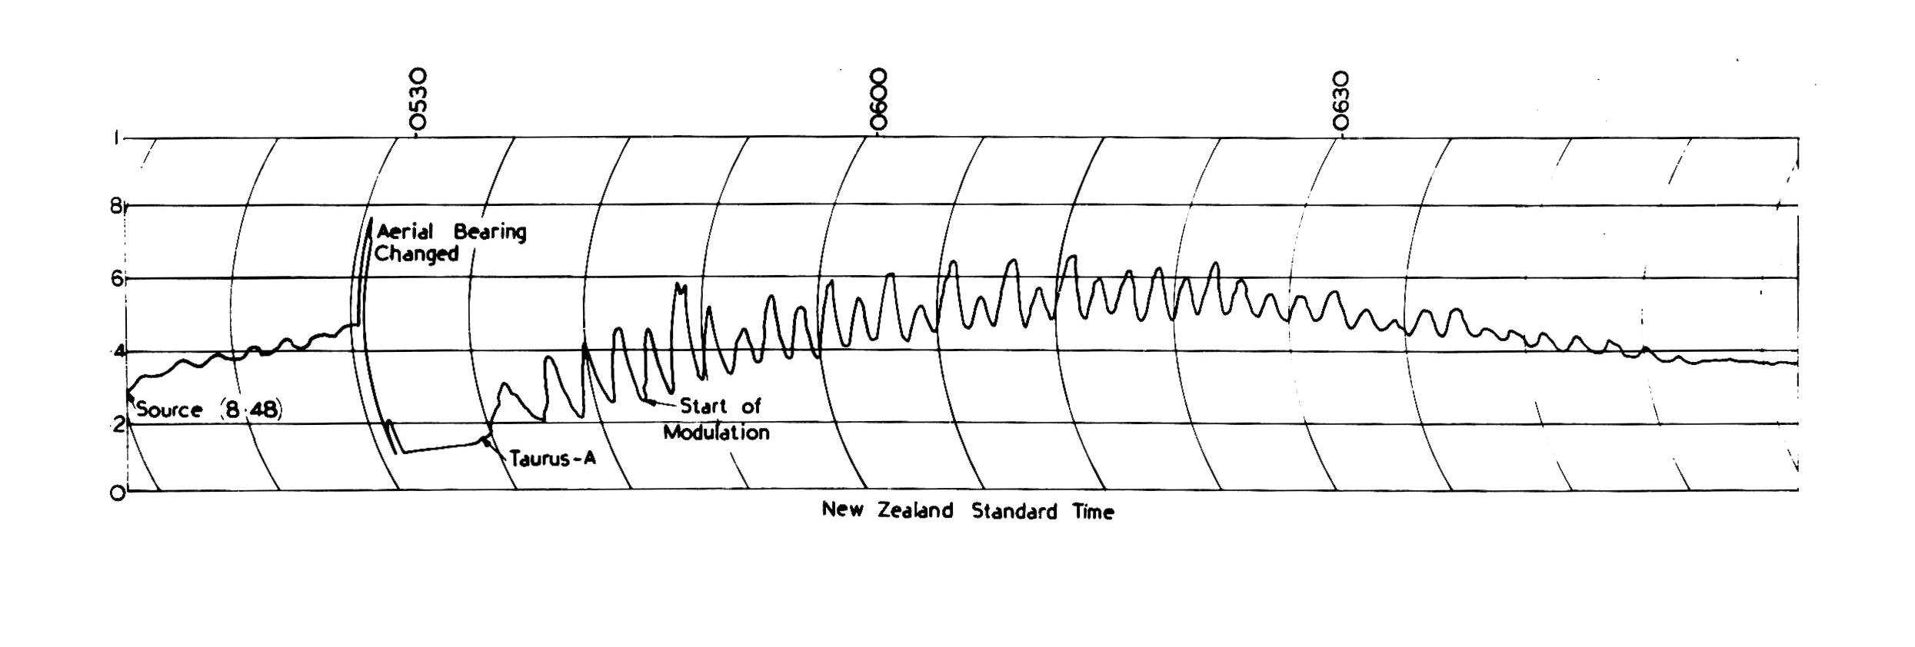
New Zealand – May 1948
Bolton and Stanley
  100MHz Yagi
Pakiri Hill near Leigh
Piha (The Piano)
Aust
NZ
Positions for Cygnus A, Taurus A, Virgo A, Centaurus A
Notes:
At the end of May 1948, an ex-Army gun-laying radar trailer containing four 100Mhz Yagis, a
new 100MHz receiver, recorders, chronometers, and weather recording equipment were
shipped to New Zealand. This equipment was then moved to a site called ‘Pakiri Hill’ about
10km from a small fishing village called Leigh, about 70km north-west of Auckland. At this site
they obtained about 30 nights of observations of Cygnus-A and in mid-July five observations
of Taurus-A. A large number of observations were necessary to reduce the noise in the
sidereal time of the interference minima caused by irregular diffraction. One important
discovery that was made during these observations was that the observed amplitude
variations were of atmospheric origin and were not inherent in the source itself. Spacedaerial
observations between Leigh and Dover Heights showed almost complete correlation
between solar bursts at the two sites, but no correlation between source variations. At the
end of August 1948, the equipment was moved to a new site in New Zealand near Phia,
about 30 km north of Aukland. Over a three-week period, data was collected on four sources,
Cygnus-A, Taurus-A, Centaurus-A and Virgo-A.

Slide 11
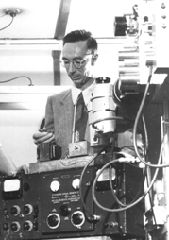
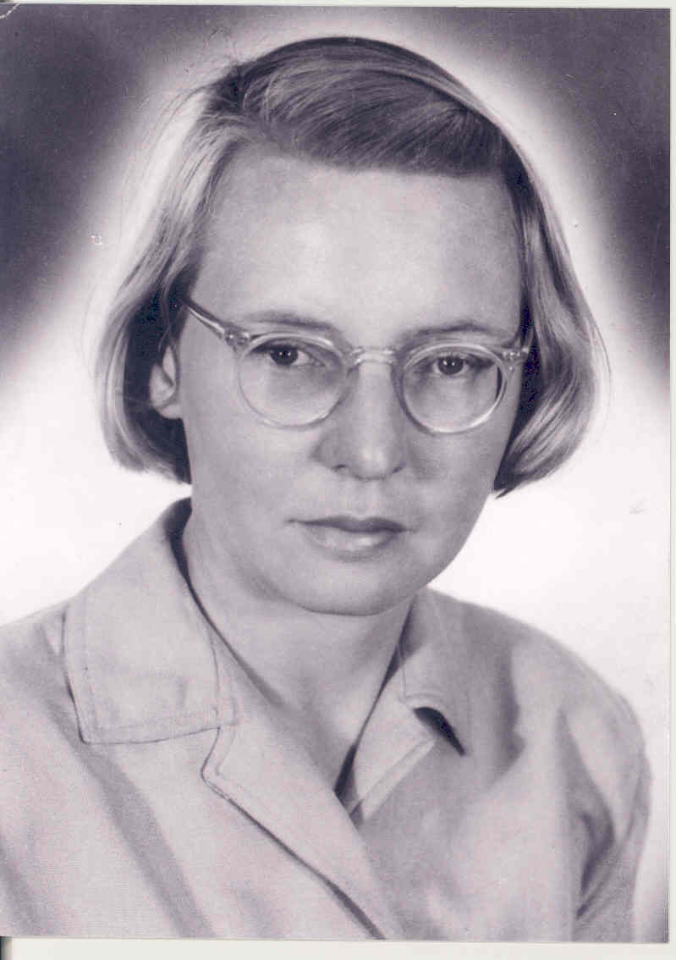
McCready, Pawsey & Payne-Scott 1947
Proc Roy Soc, Aug 1947 - received July 1946!
Used the phase of the sea interferometer fringes (lobes) to co-locate solar emission with sunspots
They note that its possible in principal to determine the actual distribution by Fourier synthesis using the phase and amplitude at a range of height or wavelength.
They consider using wavelength as a suitable variable as unwise since the solar bursts are likely to have frequency dependent structure.
They note that getting a range of cliff height is clumsy and suggest a different interference method would be more practical.
Joe Pawsey
Ruby Payne-Scott
11
Notes:
11
Added Pawsey and Payne-Scott

Slide 12
Fourier synthesis at Cambridge
1951
  Machin used an array of 4 fixed and two moveable elements and measured the solar profile.
  Analysed using Bessel functions
1952
  Ryle (Proc Roy Soc) - the phase switch
    (A+B)² → AxB
  Credits McCready et al (1947) for Fourier Synthesis concept
1953
  O'Brien publishes the first 2D Fourier synthesis
  moveable element interferometer
  Multiple hour angles
⬅
12
Notes:
12
This slide has been updated after the Hewish lecture. Sp O’Brien and recoognition of earth rotation
Note that Hogbom 1958 was unaware/didn’t make the connections to O/Brien for earth rotation synthesis.

Slide 13
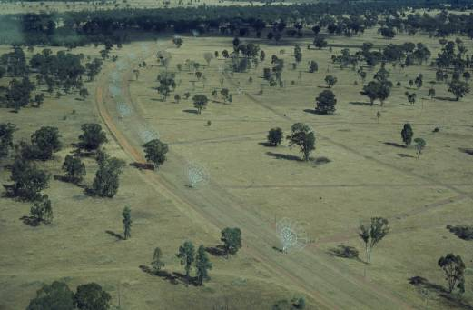
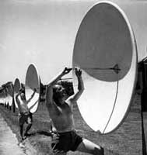
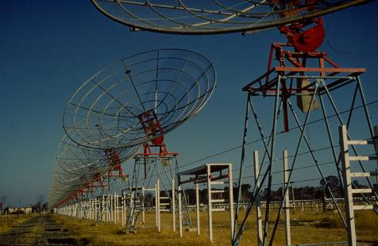
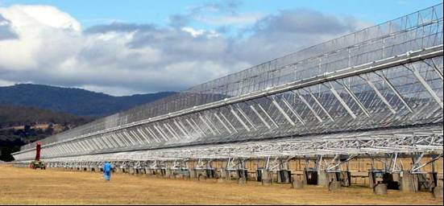
The Australian arrays
A time variable sun needs instantaneous coverage
1951
  Christiansen build the Potts Hill grating array
    32 steerable paraboloids
    an SKA path finder
1953
  Chris Cross (Fleurs)
  Mills cross
1967
  Paul Wild solar heliograph
13
Notes:
13

Slide 14
The US contemplates a National Observatory
1954
  Bob Dicke proposes a synthesis telescope for Greenbank
  based on summation of interferometer responses
  A committee decided to built a 140’ equatorially mounted dish instead and the US lost an early opportunity to become a world leader in aperture synthesis radio astronomy!
  Committees are necessarily conservative and risk averse (Crick)
14
Notes:
14

Slide 15
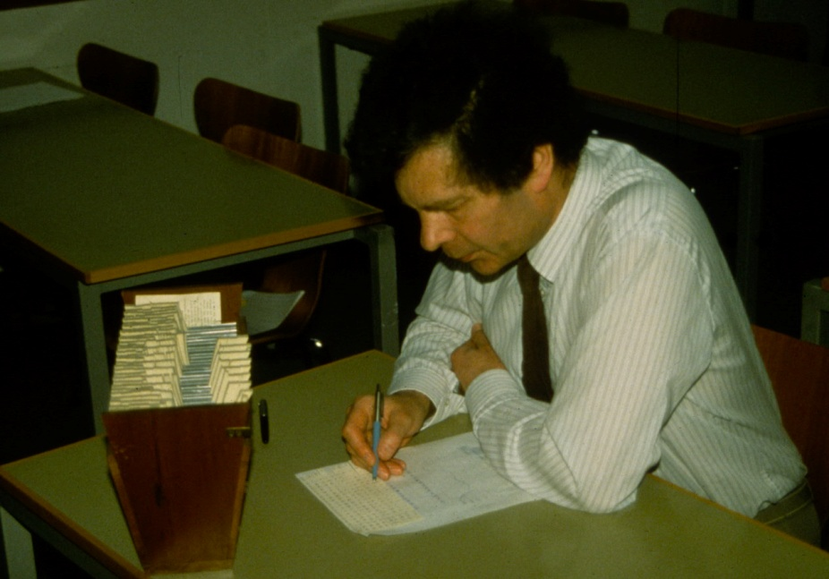
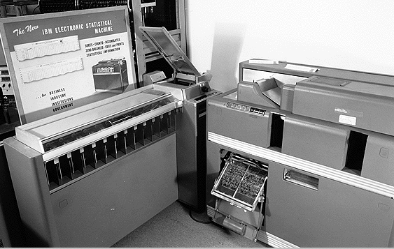
Fourier Transforms - 1953
Lipson-Beevers strips
  25x25 array to 2 digits 1 person in 24 hours
Punched card tabulator
  25x25 array to 3 digits in 8 hours (4 operators!)
Peter Scheuer with Lipson Beaver strips
15
Notes:
15
Peter Scheuer recreating the use of Lipson-Beevers strips in the 1950's (from Woody Sullivan 1988).
Removed Pearcey: Hollerith rolling-total tabulator for 2D Fourier synthesis

Slide 16
Fourier synthesis imaging - 1954
Bracewell and Roberts: Arial smoothing
  introduces invisible distributions and the principal solution
Scheuer: Theory of interferometer methods
  PhD chapter 5 (unpublished)
  Full analysis of Fourier synthesis including indeterminate structure
Independent developments, but all acknowledge Ratcliffe’s lectures
16
Notes:
16
Delete Pawsey asked Jim Roberts to write this with Ron Bracewell after his colloquium
Aust J Phys 7, p615
Scheuer: theory of the phase switch

Slide 17
Christiansen and Warburton first earth rotation synthesis (1955)
Chris takes the 1D FT of each strip distribution & does a 2D Fourier synthesis using all strips
  The way in which a 2D radio brightness distribution may be derived from a number of 1D scans is not obvious. However rather similar 2D problems have arisen in crystallography and solutions for these problems, using methods of Fourier synthesis have been found.
Reference to O'Brian (Cambridge)
17

Slide 18
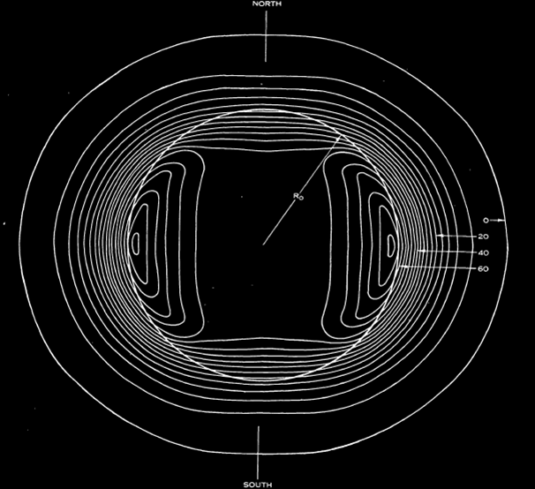
First earth rotation aperture synthesis image
The Sun at 21cm
1955
Christiansen and Warburton,
Aust J Phys 8, 474 (1955)
Notes:
Christiansen and Warburton, Aust J Phys 8, 474 (1955)

Slide 19
Computers and signal processing
19
1958
  EDSAC II completed and applied to Fourier inversion problems
1961
  Jennison had acquired Ratcliffe's lecture notes on the Fourier transform and publishes a book on the Fourier Transform
  Sandy Weinreb builds the first digital autocorrelator
1965
  Cooley & Tukey publish the FFT algorithm

Slide 20
Hogbom and Earth Rotation synthesis
1958
  Hogbom describes earth rotation synthesis to Ryle (Radio Astronomy at the Fringe , ASP 300, pp120)
    Hogbom ran the calculations on EDSACII
    Hogbom didn't think it very useful because he didn't think of using steerable antennas
  He later realised that Ryle already understood the principal but was keeping it to himself
  Hogbom was unaware of the other Cambridge work using earth rotation (eg O’Brien 1953)
20
Notes:
Note that oral history is confounded by not only changes in memory, but also it is the personal view of the individal
This is also a nice illustration of the closed v open research environment

Slide 21
Ryle & Hewish 1960
21
1960
  Ryle and Hewish MNRAS, 120, 220
  The Synthesis of Large Radio Telescopes
  no reference of any kind to Pawsey et al
  Many references to the Mills Cross as a less practical and more complex system
1962
  Ryle publishes the 1 mile telescope design
  Probably delayed publication of the idea so others wouldn't build it before Cambridge

Slide 22
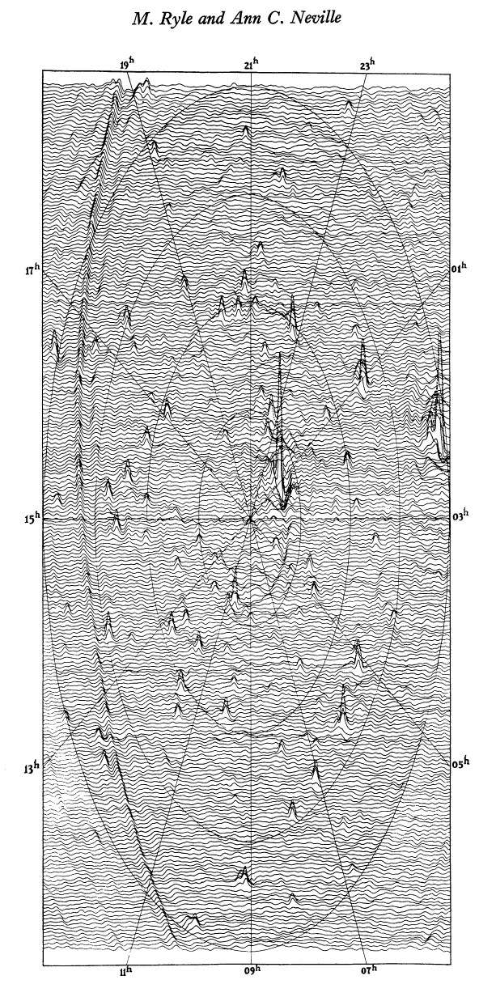
First Cambridge Earth Rotation Synthesis Image
Ryle & Neville, MNRAS 1962
June 1961
North pole survey
4C aerials
178 MHz
7 years after Christiansen
Similar results now being obtained by LOFAR & MWA!
22

Slide 23
The Elizabeth Waldram Story
Ryle & Neville, MNRAS 1962
  Elizabeth gets an acknowledgement
Computations and graphical display using EDSACII
Elizabeth did all the computations and ruled surface display
  First radio image display
Transferred to Ryle’s group from X-ray crystallography
  After being exposed to excessive radiation levels
  First member to use the crystallography software
  Not enthusiastically welcomed by Ryle
Still active in the Cambridge Radio group
  10C surveys, AMI

Slide 24
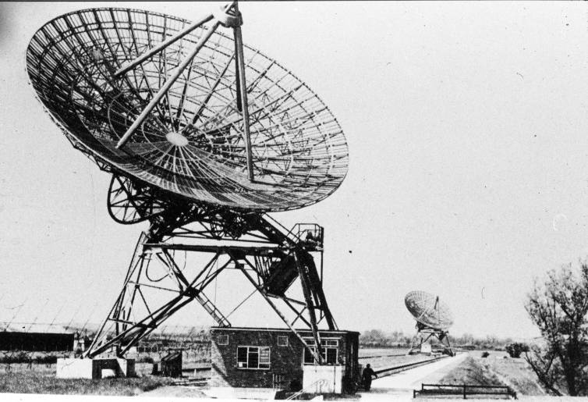
Cambridge One-Mile Telescope: 1962
24

Slide 25
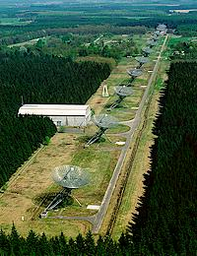
Westerbork: 1970
Hogbom (Cambridge)
+
Christiansen (Sydney)
Benelux cross → WSRT
12 x 25m dishes 1.5km
  Two moveable
  10 redundant spacings
  Self calibration
  Two more dishes at 3km added later
Notes:
From Blauuw

Slide 26
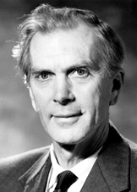
Nobel Prize 1974
Sir Martin Ryle
for his observations and inventions, in particular of the aperture synthesis technique
from the presentation
“The radio-astronomical instruments invented and developed by Martin Ryle, and utilized so successfully by him and his collaborators in their observations, have been one of the most important elements of the latest discoveries in Astrophysics.”
26
Notes:
26
And from the presentation for Ryle:
The radio-astronomical instruments invented and developed by Martin Ryle, and utilized so successfully by him and his collaborators in their observations, have been one of the most important elements of the latest discoveries in Astrophysics.

Slide 27
US Synthesis Telescopes ⇨ VLA
Bob Dicke 1954
Joe Pawsey 1961-2
John Bolton OVRO two element interferometer 1962
NRAO 3 element interferometer 1964-5
NRAO proposed VLA in 1967
  Ryle – it will not work (troposphere)
  Fixed A array configuration
  No known way to generate the images
  Cant keep this number of cryogenic receivers working
  No deconvolution
  No self calibration
VLA operational 1980

Slide 28
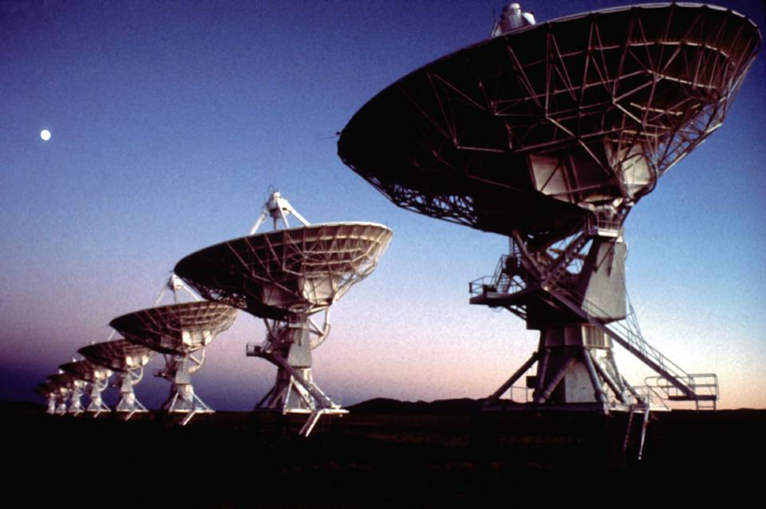
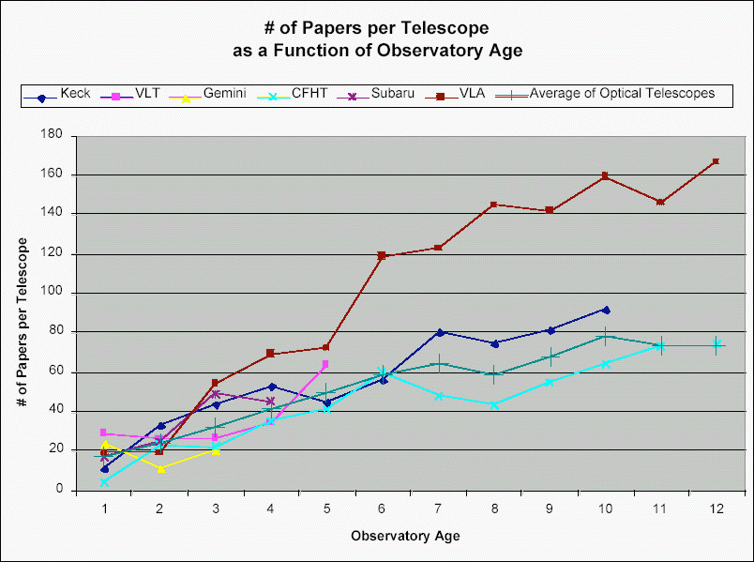
VLA
New Mexico
1980
Notes:
28

Slide 29
Deconvolution
1968
  Hogbom does first clean experiments
  NRAO 3 element data
1971
  first cleaned image published
    Rogsstad and Shostak (OVRO HI image)
1974
  Hogbom publishes the CLEAN algorithm
Use of deconvolution very controversial in the 1970’s

Slide 30
Self Calibration
1958: Phase and amplitude closure
  Jennison (Jodrell Bank)
1977: Redundant spacing interferometry
  Hamaker , O’Sullivan, Noordam (Westerbork)
1974-79: Phase closure in VLBI imaging
  Rogers, Yee, Readhead, Cotton….
1980: Antenna based calibration
  Clark, Schwab (VLA)
1983: Self cal ≡ phase closure ≡ adaptive optics
  Cornwell
Notes:
1974: Adaptive optics
Muller & Buffington

Slide 31
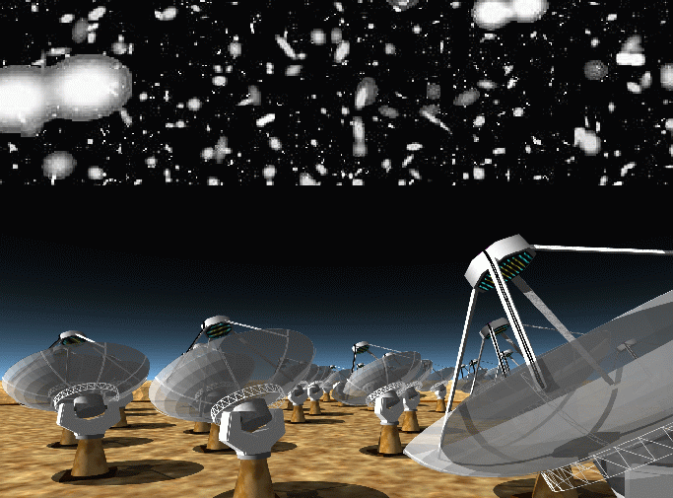
SKA 2020
31

