Slide 1
Phased Array Feeds
SKANZ 2012
John O’Sullivan
CSIRO Astronomy and Space Science,

Slide 2
Why phased array feed
The need for Field of View
  Survey speed
FoV α1/Collecting area α 1/sensitivity for single collector
Options
  Many small collectors ➔ huge correlator/imager cost
    Small single pixel dishes
    Aperture array
  Fewer small collectors with concentrators
Rather than have separate feeds think aperture synthesis applied to focal plane!
Preferred option depends on:
  Cost tradeoffs – electronic vs steel and fabrication costs
  Performance eg efficiency, calibration accuracy, dynamic range, ability to “tune out” spillover etc
Phased array feed
Multiple beams
Correlator and further processing
Beamformer

Slide 3
Some basic phased array feed physics
The array must fully sample the incoming fields – no grating lobes
  Collect all the incident energy
  Necessary for interpolation between array ports – flat field
  Necessary for removal unwanted spillover noise contribution
  Correct for aberrations/distortions
Array port beams overlap (similar amplitude different phase slope)
  All array ports are fundamentally coupled to each other
  Share power from source ➔ poor individual port gain compared to an isolated antenna
Array is like interferometer and desired signals must come from dish – transform of (u,v) visibility has a cutoff.
  Spillover comes from beyond the dish and can be filtered out

Slide 4
Array and image beamforming
Other antennas
Array
Beam-former
Array
Raw array ports (r)
Pre-correlator beamformed (b)
Post-correlator beamformed (c)
Synthesis
Beamform
Image
beamform
Array beamformer must form max sensitivity beams (or else must measure cross correlations between ports!!!)
Image beam forming to make flat field primary beam
Synthesis beamforming to make final maps

Slide 5
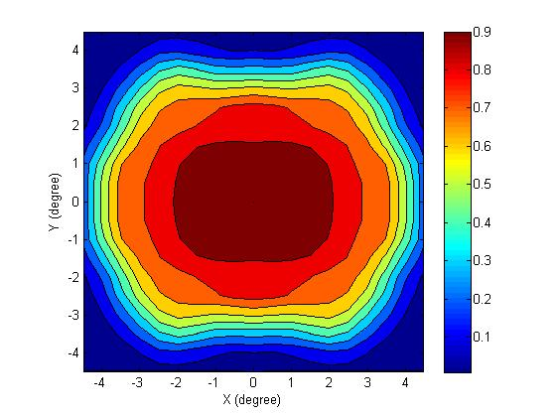
The flat composite primary beam field of view
ASKAP 188 port array at 1200 MHz
Courtesy Rong-Yu Qiao
Based on full electromagnetic plus electronic model devel. By SJ Hay and myself

Slide 6
Musings on processing and calibration
Basically we want the gain/phase/polarisation of the composite wide flat field at each point
  This must be a highly constrained, bandlimited function composed of known per telescope basis functions
Have many measurements simultaneously
  Multiple interferometers
  Multiple overlapping port beams to form fewer beams
  Multiple sources in any field to solve
The resulting synthesis (ie dirty) beam varies (slowly) from point to point if we choose not to adjust for errors in real time
The result may be a greater ability to use internal consistency for calibration than single field interferometers!

Slide 7
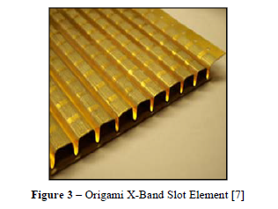
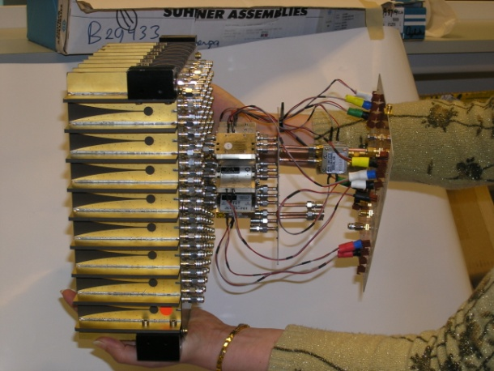
Array element options
5x4x2x2 Checkerboard FPA
8x9x2 Vivaldi element FPA
Ivashina et al, Astron
Clark et al, DARPA
Many options – patches, dipoles, slots, horns, apertures
To first order very similar – minimum coupling is fundamental to any radiating structure – some may be worse
Ultimately, the ability to match over required bandwidth determines the sensitivity – depends on coupling!!
We initially chose the Checkerboard for ease of electromagnetic modeling and manufacture

Slide 8
ASKAP – Receiver Block Diagram
Focus Package
Antenna Pedestal
40 m
570 MHz IF
BW=300MHz
700-1300 MHz
1000-1800 MHz
LO1
5850-6650 MHz
LO2
4430 MHz

Slide 9
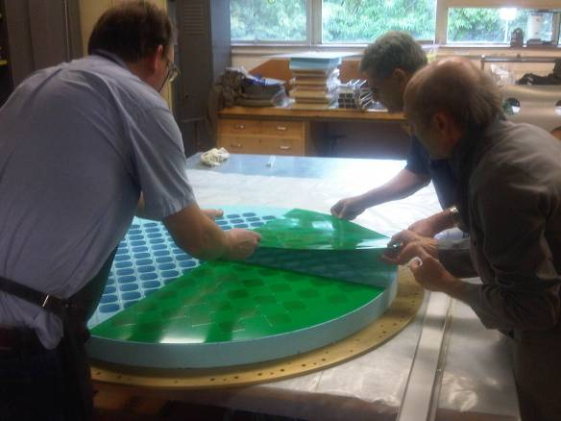
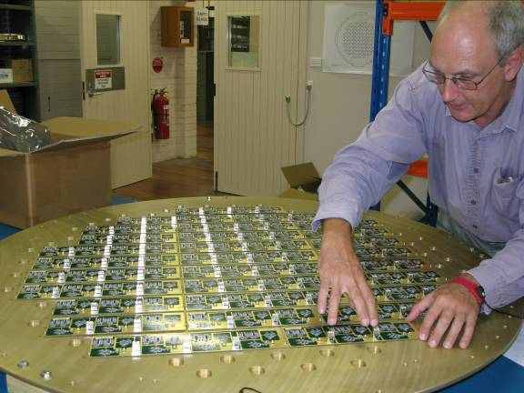
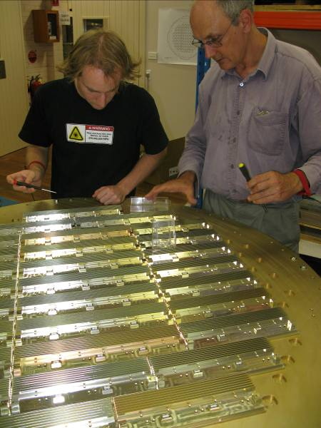
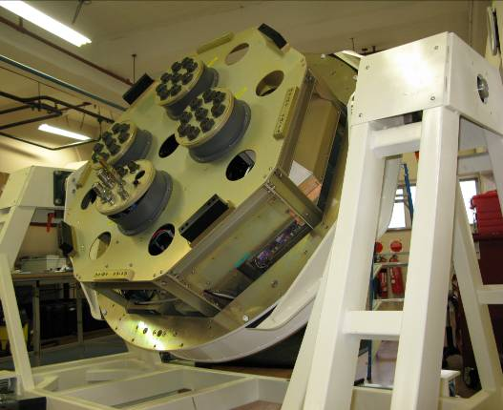
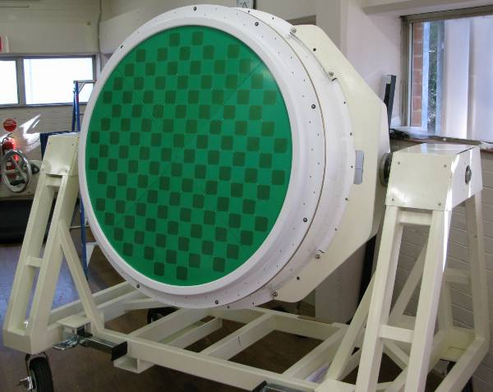
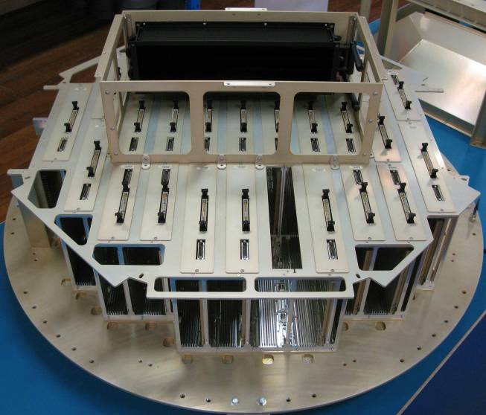
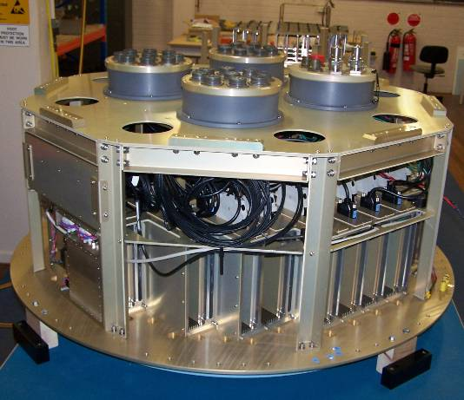
ASKAP Phased Array Feed construction

Slide 10
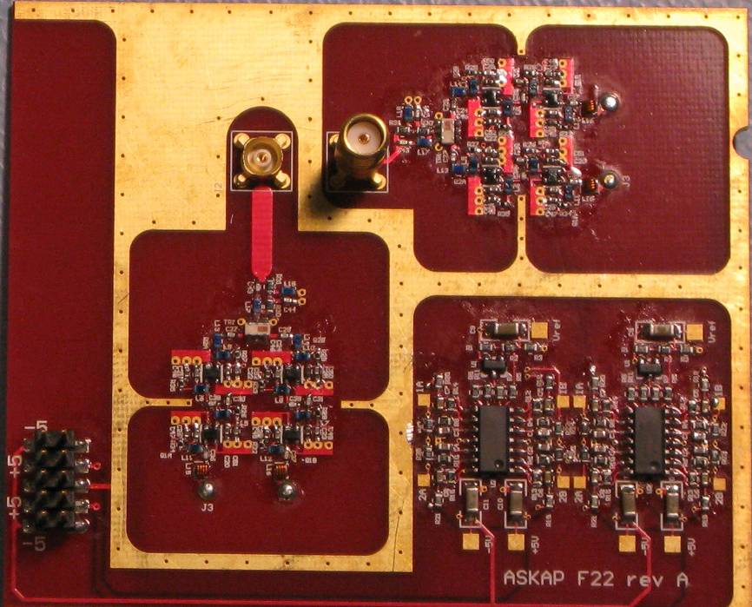
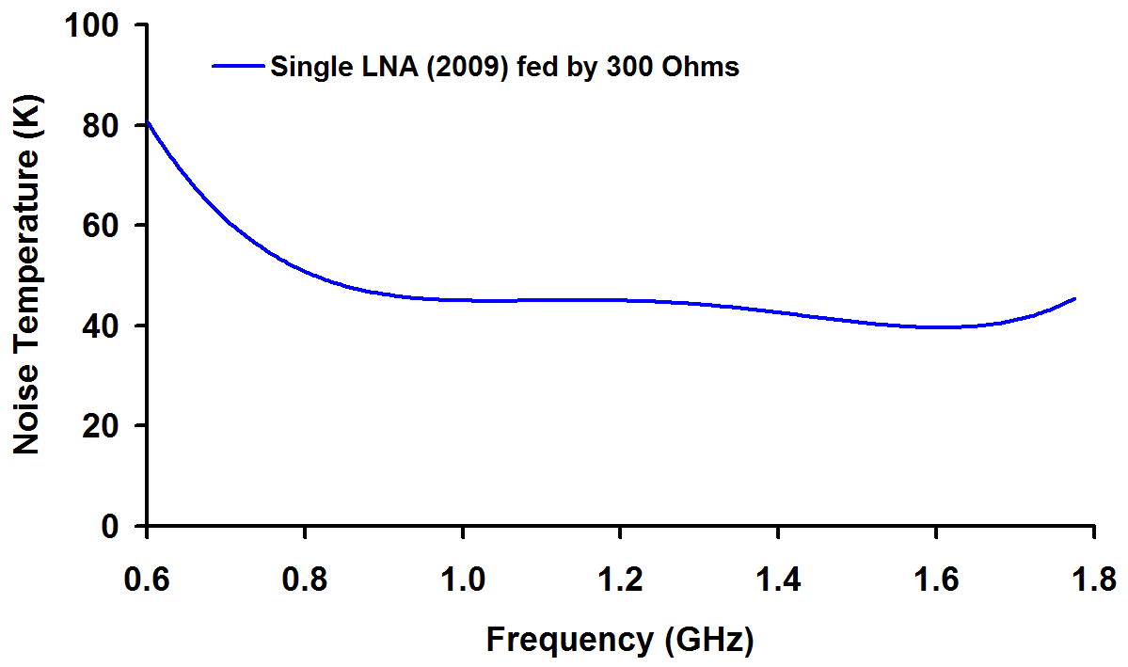
ASKAP Low-noise amplifier
Design frequency range:
  0.7 – 1.8 GHz
Design system impedance at input :
  300 Ω (differential)
Low noise transistors:
  Avago ATF 35143
Two stages of gain
  Configured as two independent amplifiers with a single (difference) output
Gain:
  28 dB
Noise temperature:
  40 – 60 Kelvin
  (measured in a 300 Ω differential system impedance)

Slide 11
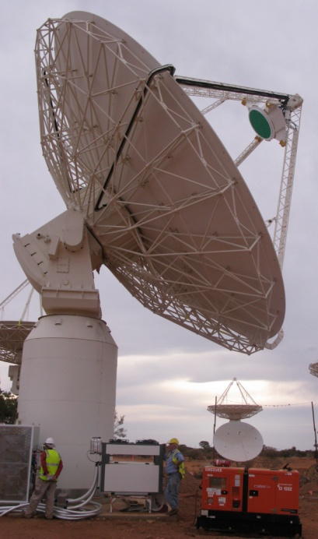
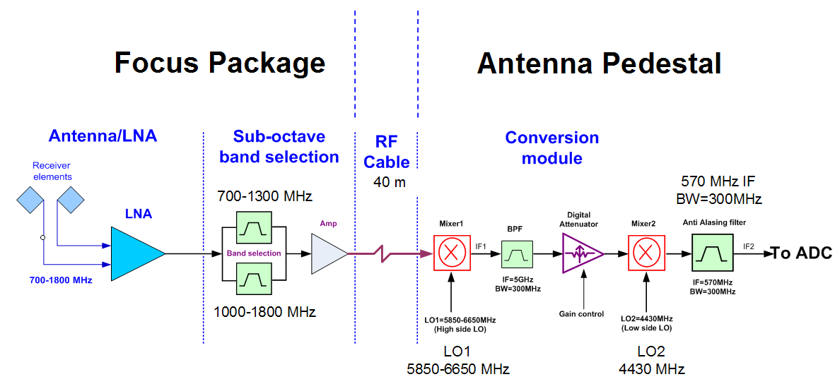
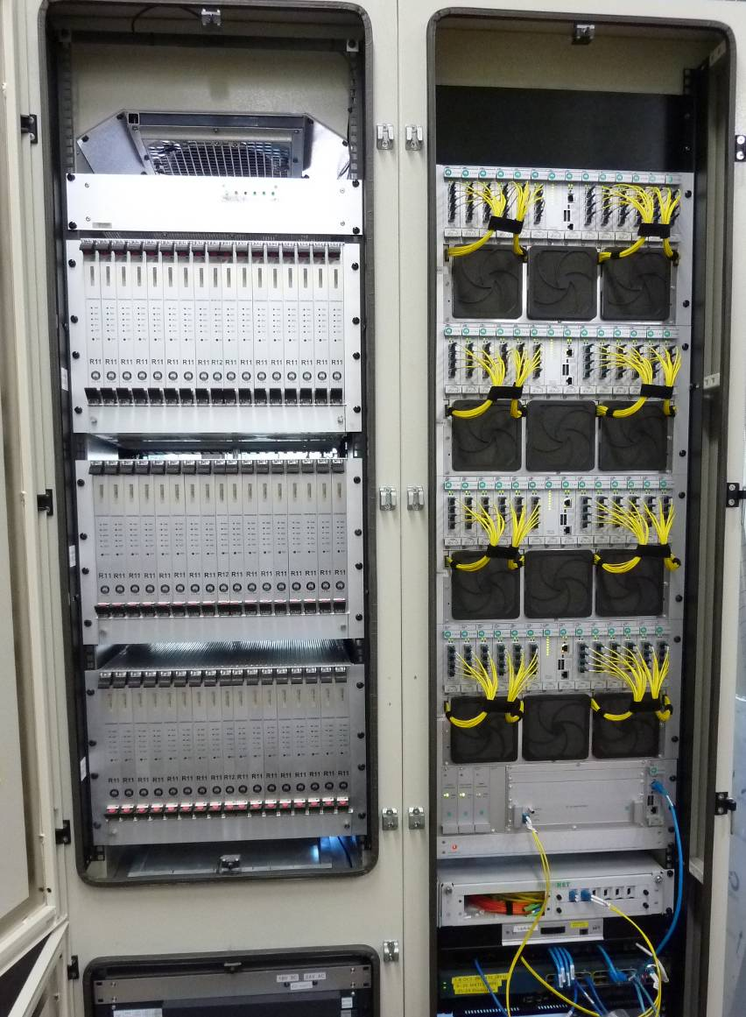
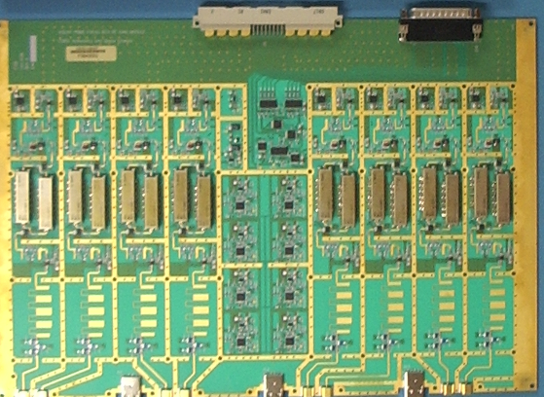
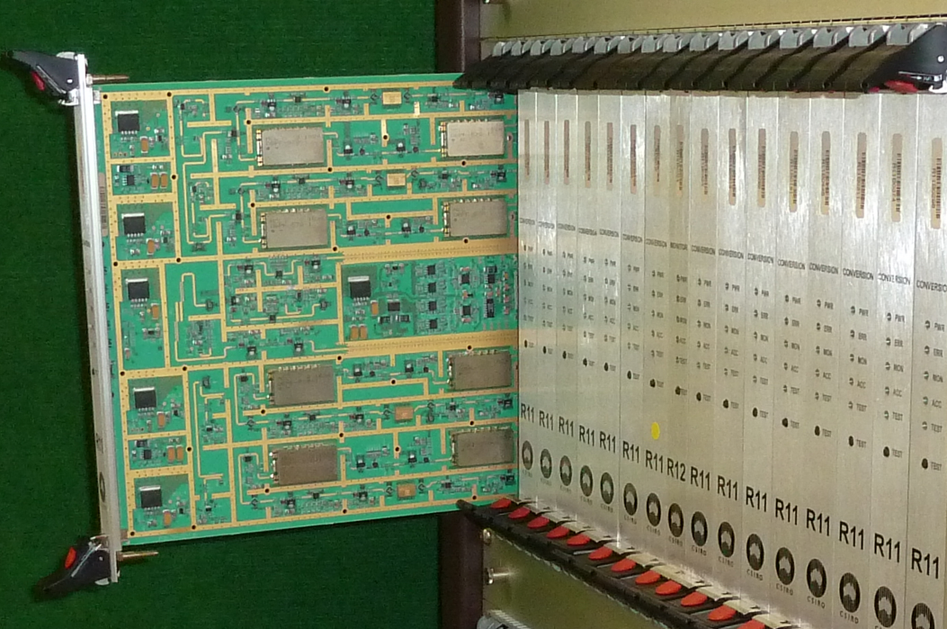
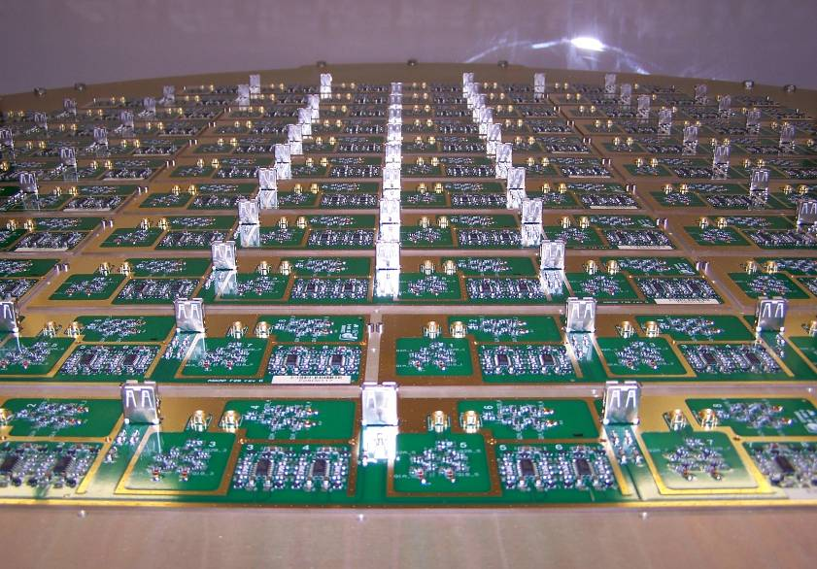
ASKAP Receiver Electronics

Slide 12
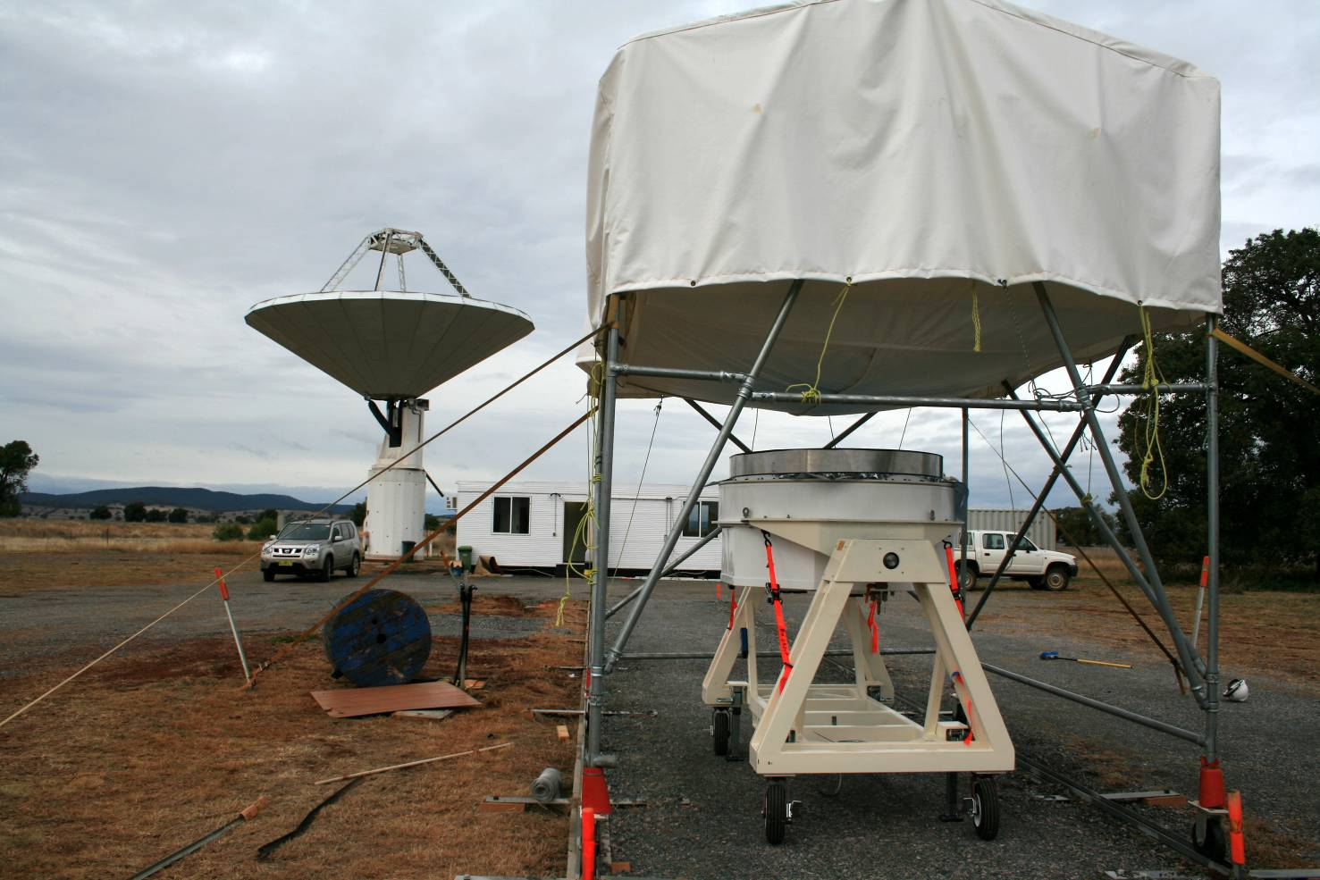
June 2011: First results –aperture array
Ground-based aperture array measurements
  Y-factor measured with Cold sky and Hot load + all correlations

Slide 13
June 2011: First results – aperture array
Ground-based aperture array measurements
Boresight beamformed noise contribution from the PAF
< 50 Kelvin (0.75 - 1.2 GHz)
  This is consistent with best expected performance of the array
Noise increases significantly above 1.2 GHz
  Indicating that the co-optimis-ation needs to be improved in this part of the band.
Design enhancement is currently nearing test
  So that the receiver noise performance will approach 50 Kelvin across the <0.7 GHz to 1.8 GHz ASKAP band.
Sensitivity matching conditions: Hay, IJMOT Vol.5, No.6, 2010 and ICEAA 2010.
Measurement: unpublished

Slide 14
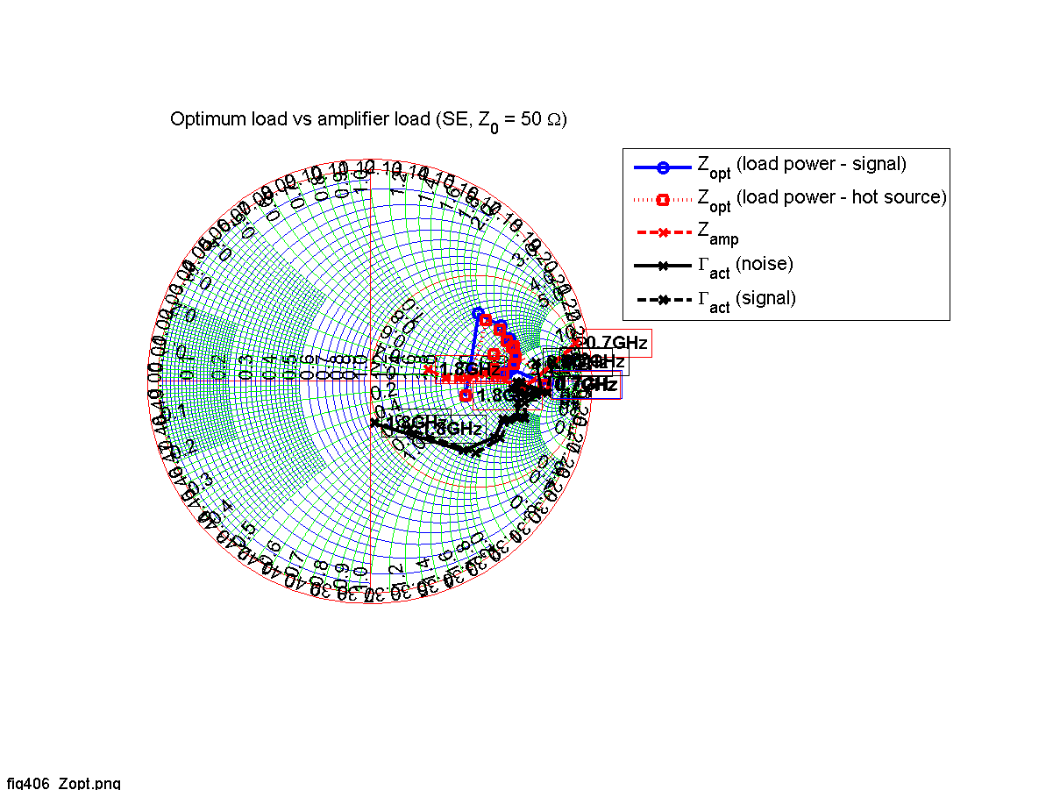
Matching LNA to array
Measured LNA optimum noise match source load vs active impedance of modelled array (current)
Array has active impedance which must be equal to the optimum for the LNA to achieve noise near the best the LNA can achieve
Next version (to be tested shortly) will be much better!

Slide 15
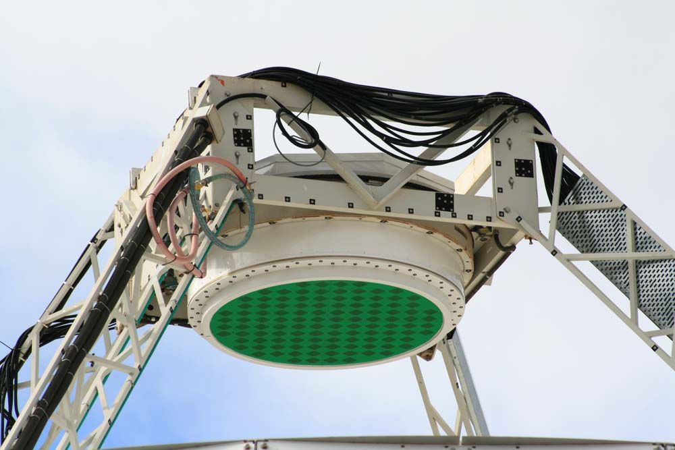
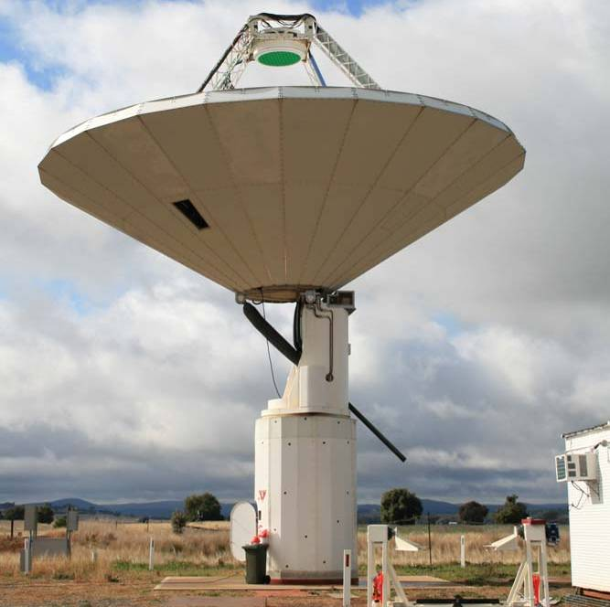
June 2011: ASKAP PAF installed on Parkes Testbed
CSIRO. ASKAP PAF development update July 12, 2011

Slide 16
Phased array feed – Parkes 12m

Slide 17

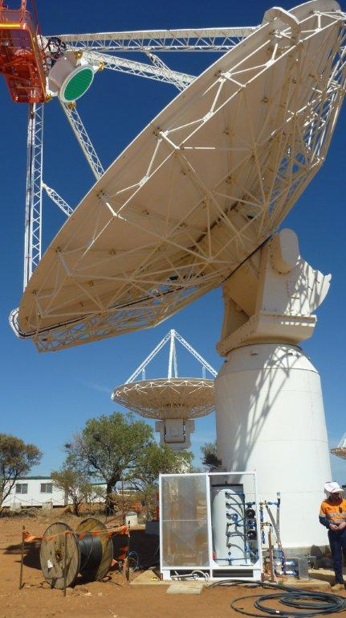
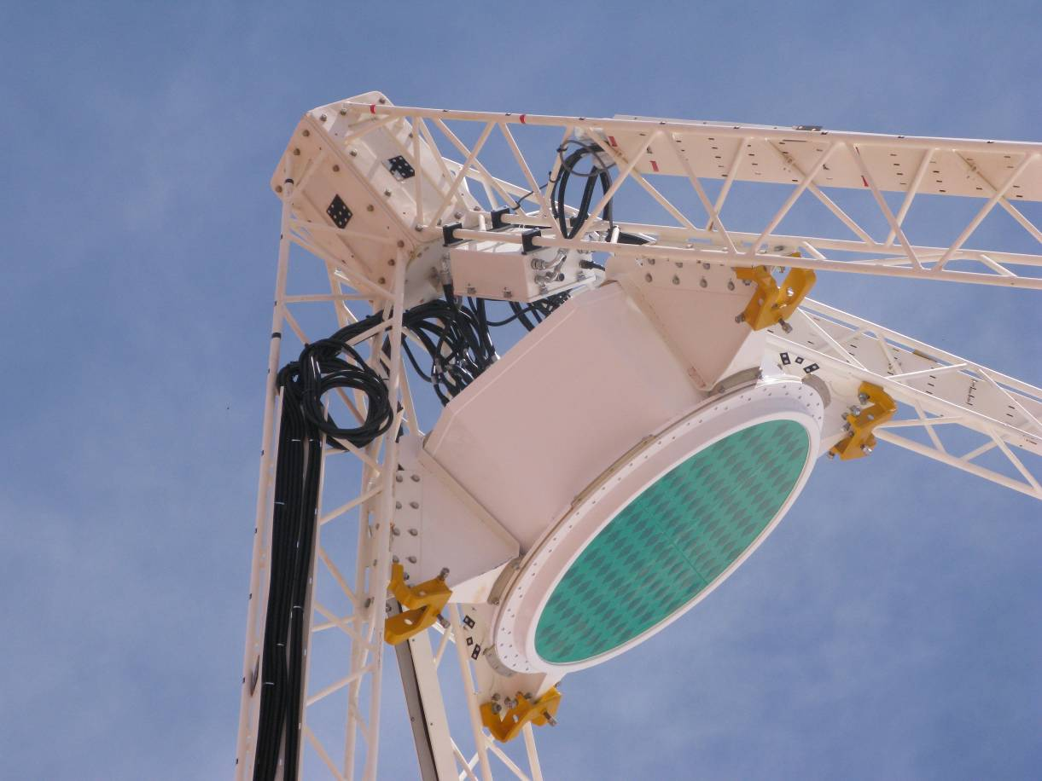
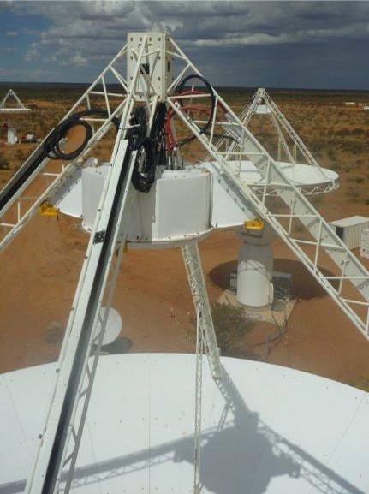
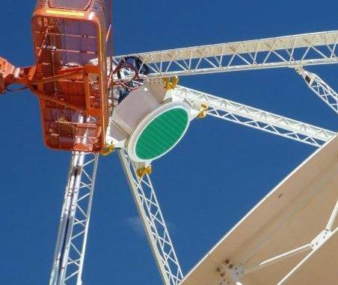
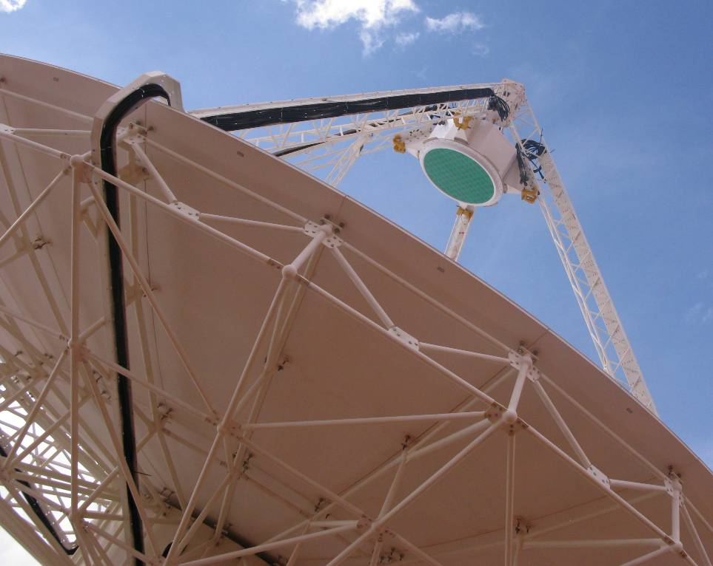
October 2011: ASKAP PAF installed in Boolardy
CSIRO. ASKAP PAF development update July 12, 2011

