Slide 1
Digital Receivers for Radio Astronomy
Paul Roberts
CSIRO Astronomy and Space Science
Engineering Development Group

Slide 2
Plan
Digital receiver
- definition
- differences between analogue receivers and types of digital receivers
Pro and cons of using a fully digital receiver.
Currently used digital receivers
- eg ASKAP Design Enhancements
SKA digital receivers
- specs
- current implementation options
Summary and suggestions for the immediate future

Slide 3
Digital Receivers
Digital receiver
Digitise input RF band without prior down-conversion and analogue processing
Performs all signal processing operations in the digital domain (software defined radio)
Dividing line between firmware/software flexible

Slide 4
Conventional Receivers
Sample
clock
ADC
ANT
LNA
LO1
LO2
Typical Analogue Receiver
Digital
Spectrum

Slide 5
Digital Receivers
ADC
ANT
LNA
Gain
Digital
Spectrum
Digital Receiver with direct/bandpass sampling

Slide 6
Digital Receivers
ADC
ANT
LNA
Gain
Full Band Filter
Fully digital receiver
Digital
Spectrum

Slide 7
Digital Receivers
Advantages of fully digital receivers over analogue
- flexibility
- simplification
- integration
- production
- cost

Slide 8
Digital Receivers
Flexibility
Adaptable signal processing – research instrument
All information present – allows innovative signal processing
- adaptive RFI filter etc
- programmable dedispersions etc
- a particular example real-time time-domain RFI excision

Slide 9
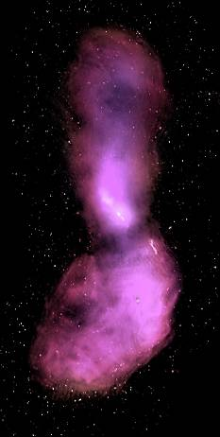
Parkes 21cm Multibeam Experiment
Centaurus A neutrinos
RFI
Veto

Slide 10
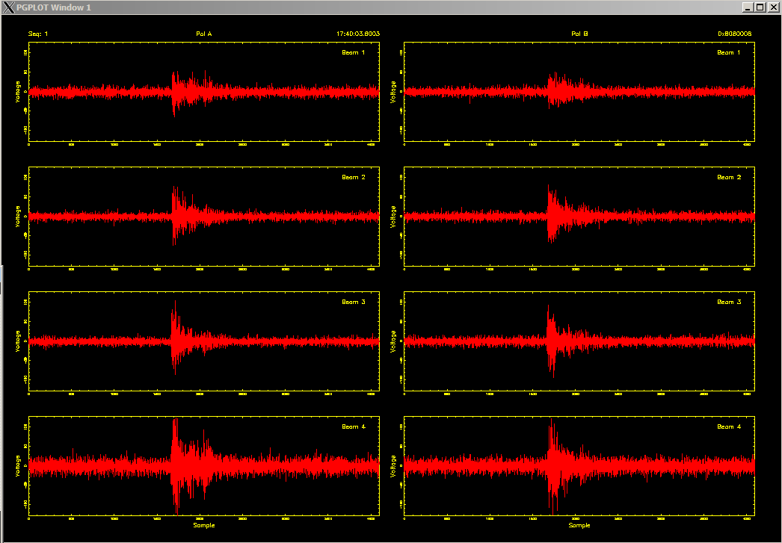
Parkes: RFI pulse
Pol A
Pol B
4 micro sec
4 micro sec

Slide 11
Digital Receivers
Simplification
Numerous analogue components replaced with a few (complex) digital components
Analogue parts difficult to tune/match.
A single LO (the sample clock)
Integration
Lowering complexity key to building large systems affordably and efficiently
Critical for large number of signal paths – PAFS
Reduces power consumption – ongoing costs/cooling
and weight (ideally near focus)

Slide 12
Digital Receivers
Production
Analogue systems time consuming/complicated to test
Digital systems can take advantage of well developed test protocols like BSCAN and other digital self-test
Cost
Rides on the back of high-volume semiconductor fabrication technology – potential for low cost if sufficient volume
CMOS RF devices designed with a measure-and-calibrate approach. Allows standard cmos process to be used
e.g ASKAP ADCs about 1/10 of cost of prev generation
- Implications for SKA receiver system design

Slide 13
Digital Receivers
Challenges of fully digital receivers
- stability
- present cost in small volume
- self generated interference
- performance
Stability - high gain at a single frequency from ADC to LNA
- wider bandwidth helps
Interference - RF and digital co-located in a small volume. Optimal
implementation has receiver near focus.
Cost - currently at the low volume/prototyping point
- custom IC devices expensive if not sufficient volume
Performance
- out-of-band interference etc.

Slide 14
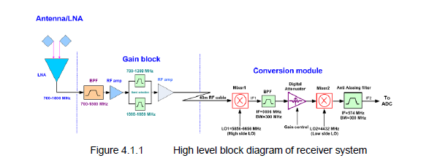
ASKAP’s Design Enhancement simplification
ADC
ADC

Slide 15
Digital Receiver for SKA
Canonical SKA –> DC-15 GHz fully digital receiver including
signal processing (band-selection @2GHz, filtering, adaptive RFI control, fringe rotation, delay compensation, – beam forming further down the chain.
Approaches available today:

Slide 16
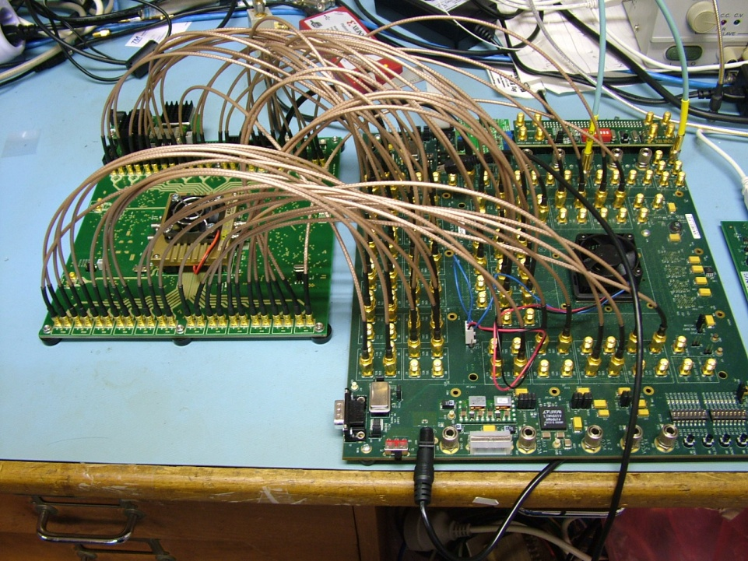
Digital Receiver for SKA
Implementation based on available prototype devices
Micram 6-bit, DC-15 GHz, 30 GS/s ADC prototype coupled to Xilinx LX240 FPGA
Current CASS development platform
Small scale production and prototyping solution – high speed interconnects – in and out of chips

Slide 17
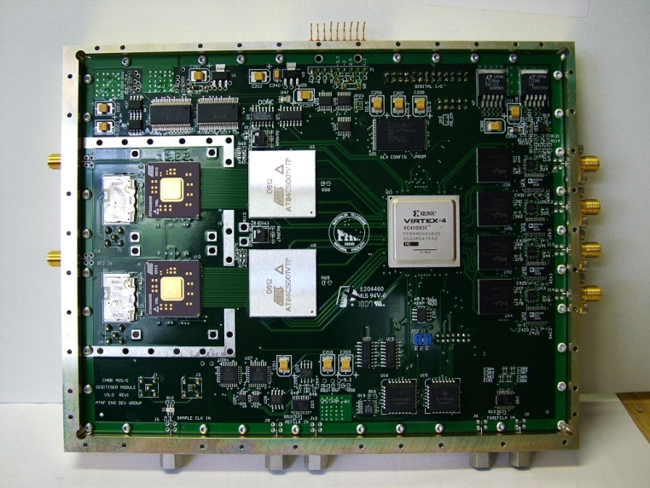
Digital Receiver for SKA
Direct receiver ASIC for SKA?
SKA will require high-integration solutions to be practical for thousands of signal paths (power, cost, complexity) –especially for PAFS
Technology exists now to develop a direct digitisation ASIC with ability to satisfy SKA requirements (100/400 Gbit Optical Transmission Market)
Can incorporate digitisation, signal processing and serial data drivers – RF-to-data

Slide 18
Notes:
4.4 W for 1800 MHz ASKAP adc’s
65nm CMOS

Slide 19
ASIC for SKA
Cost of NRE main impediment – too much for one institute but not-unreasonable in SKA context considering savings
Libraries can be accessed at minimal cost
Can produce a virtual design guaranteed to meet timing
Can produce virtual design without committing to expensive layout
Having a synthesised complete design ready for layout would provide leverage when SKA funding decisions are made
Expertise in all areas required

Slide 20
Summary
Fully digital receivers offer many attractive features for Radio – Astronomy
Technology has recently advanced to the point where this is feasible for SKA

Slide 21
Thank you
CASS Engineering Development Group
Dr. Paul Roberts
Phone: 61 2 9372 4365
Email: paul.roberts@csiro.au
Web: www.csiro.au/org/cass
Contact Us
Phone: 1300 363 400 or +61 3 9545 2176
Email: enquiries@csiro.au Web: www.csiro.au

