Slide 1
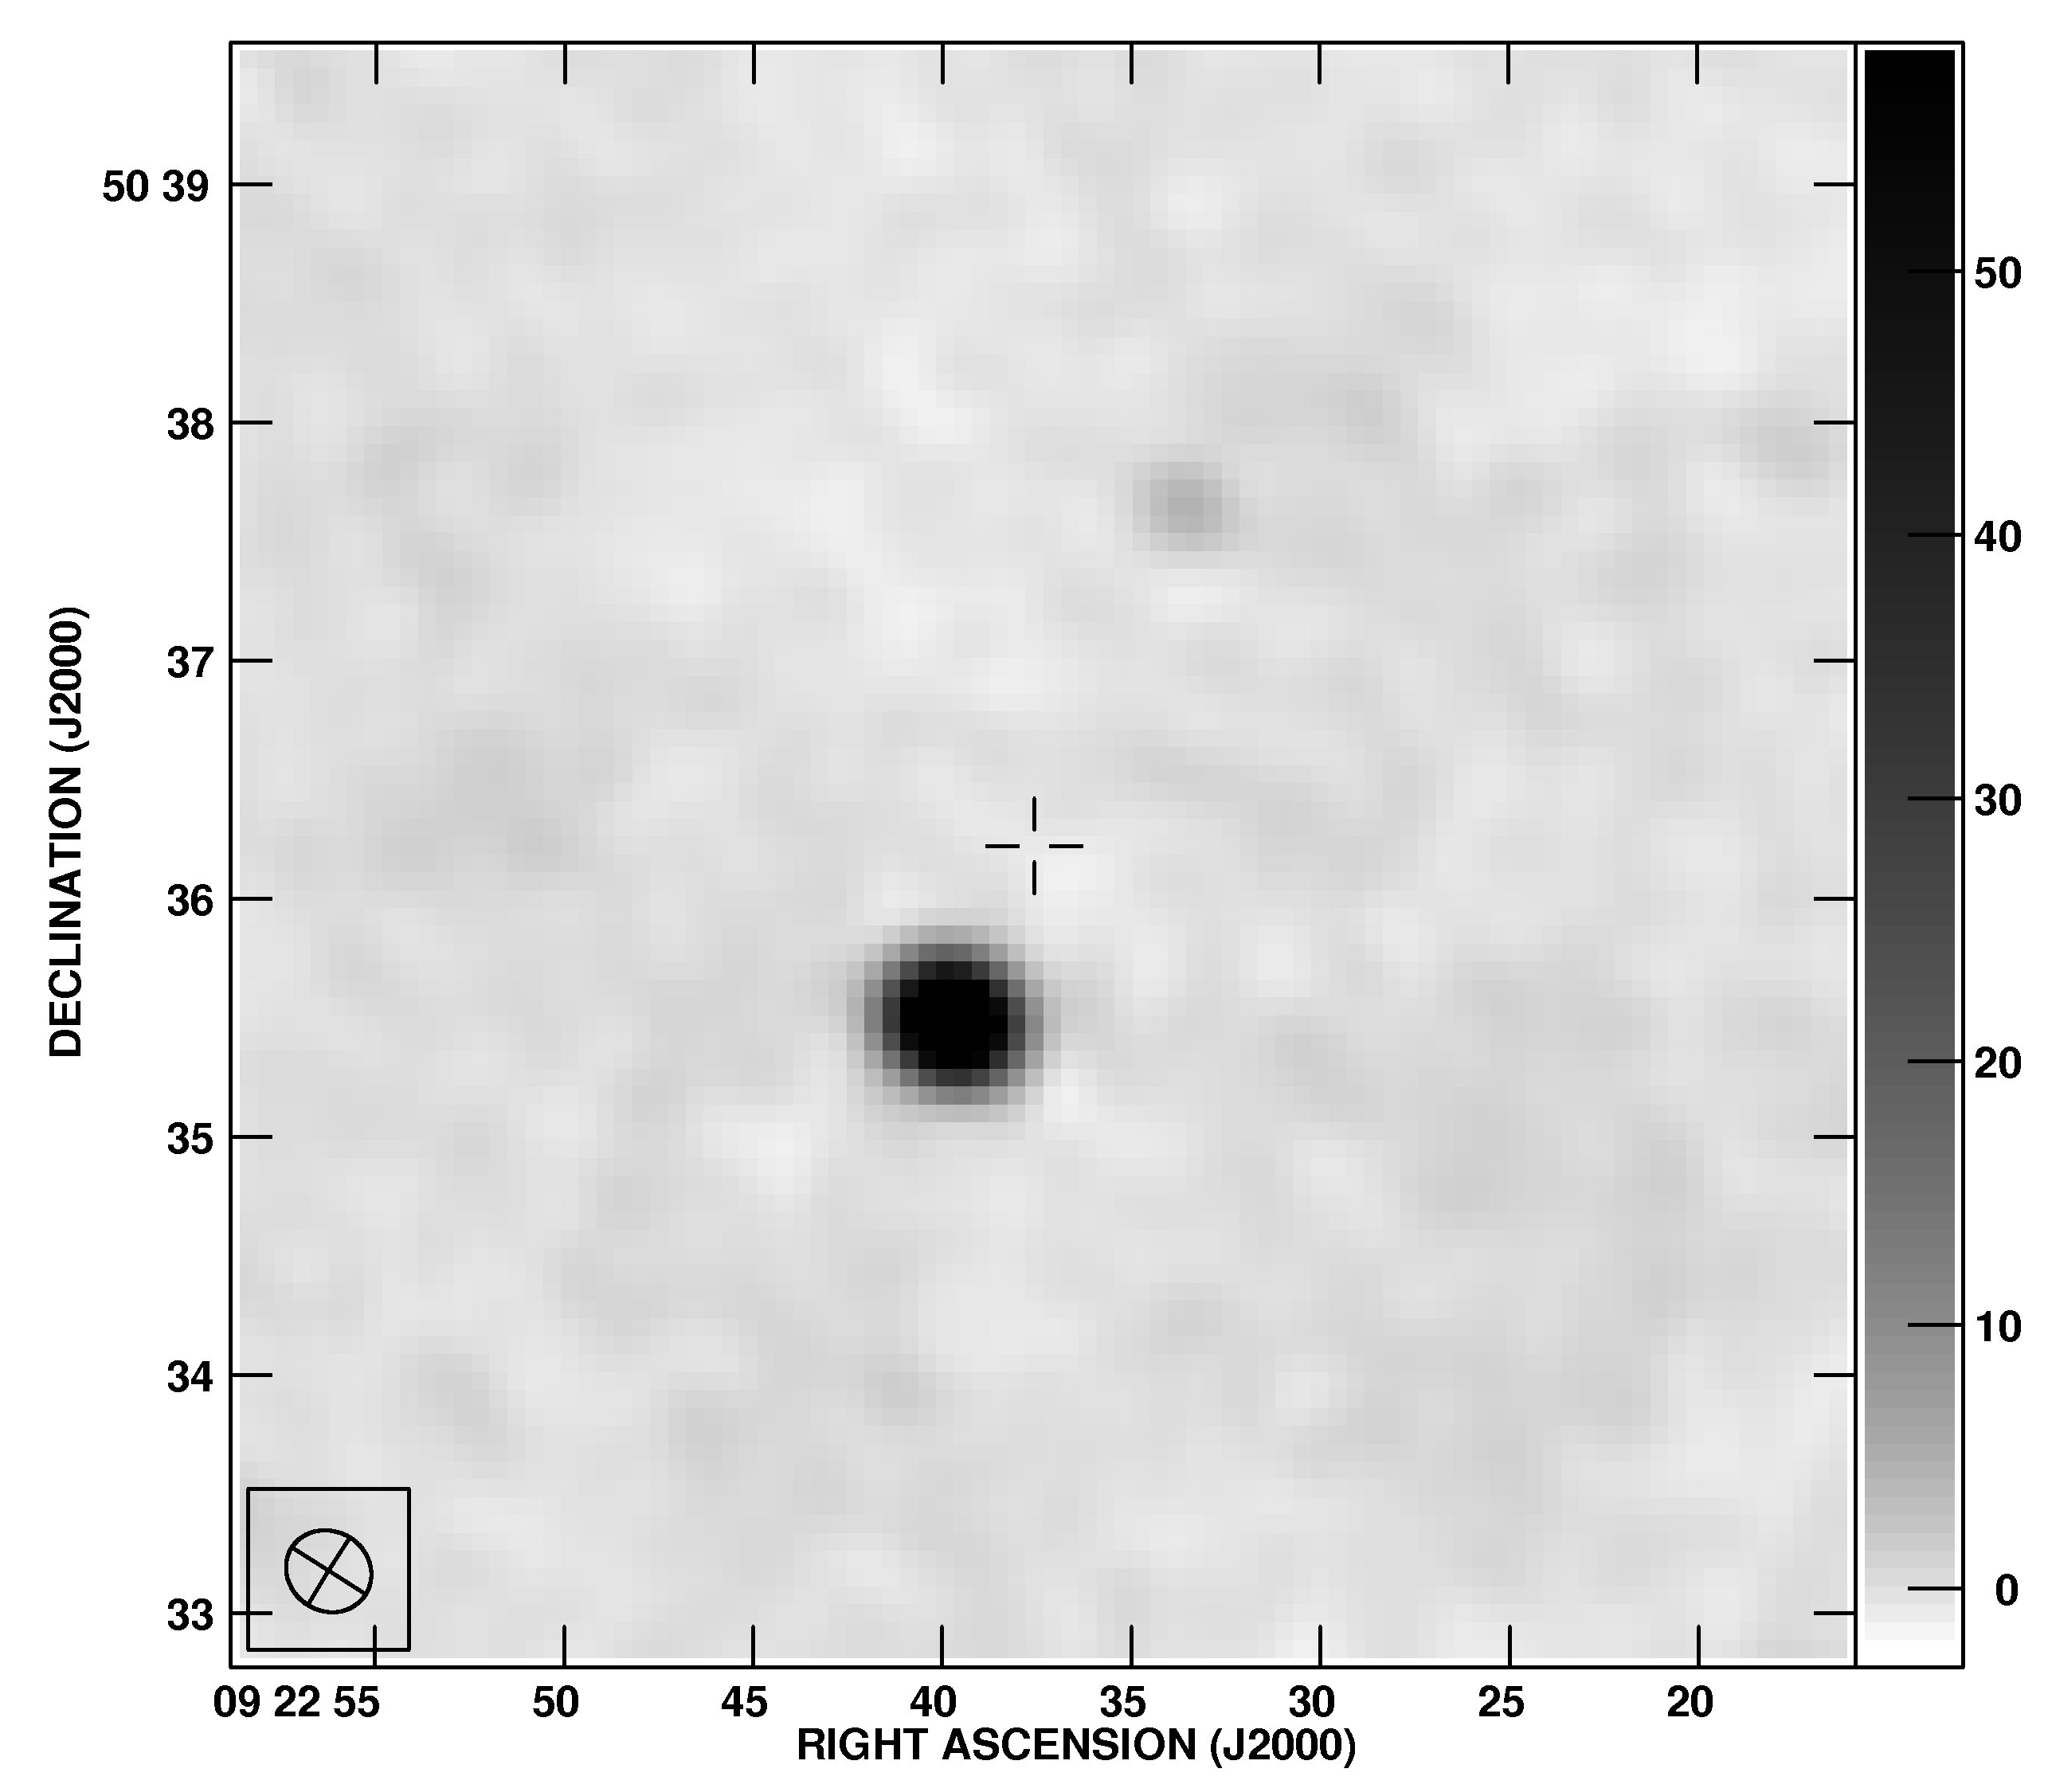
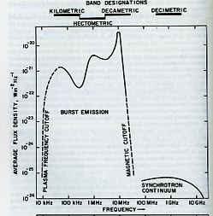
Extrasolar Planetary Radio Emission Joseph Lazio (JPL/CIT)
Jupiter, Saturn, Uranus, Neptune, and Earth emit radio emission
Generated by planetary magnetic field-solar wind interaction
Searches for extrasolar planetary radio emission date back at least to 1977
Experience suggests ν < 100 MHz required (Jupiter, HD 80606 b)
… potentially below 50 MHz
© 2012 California Institute of Technology. Government sponsorship acknowledged.

