Slide 1
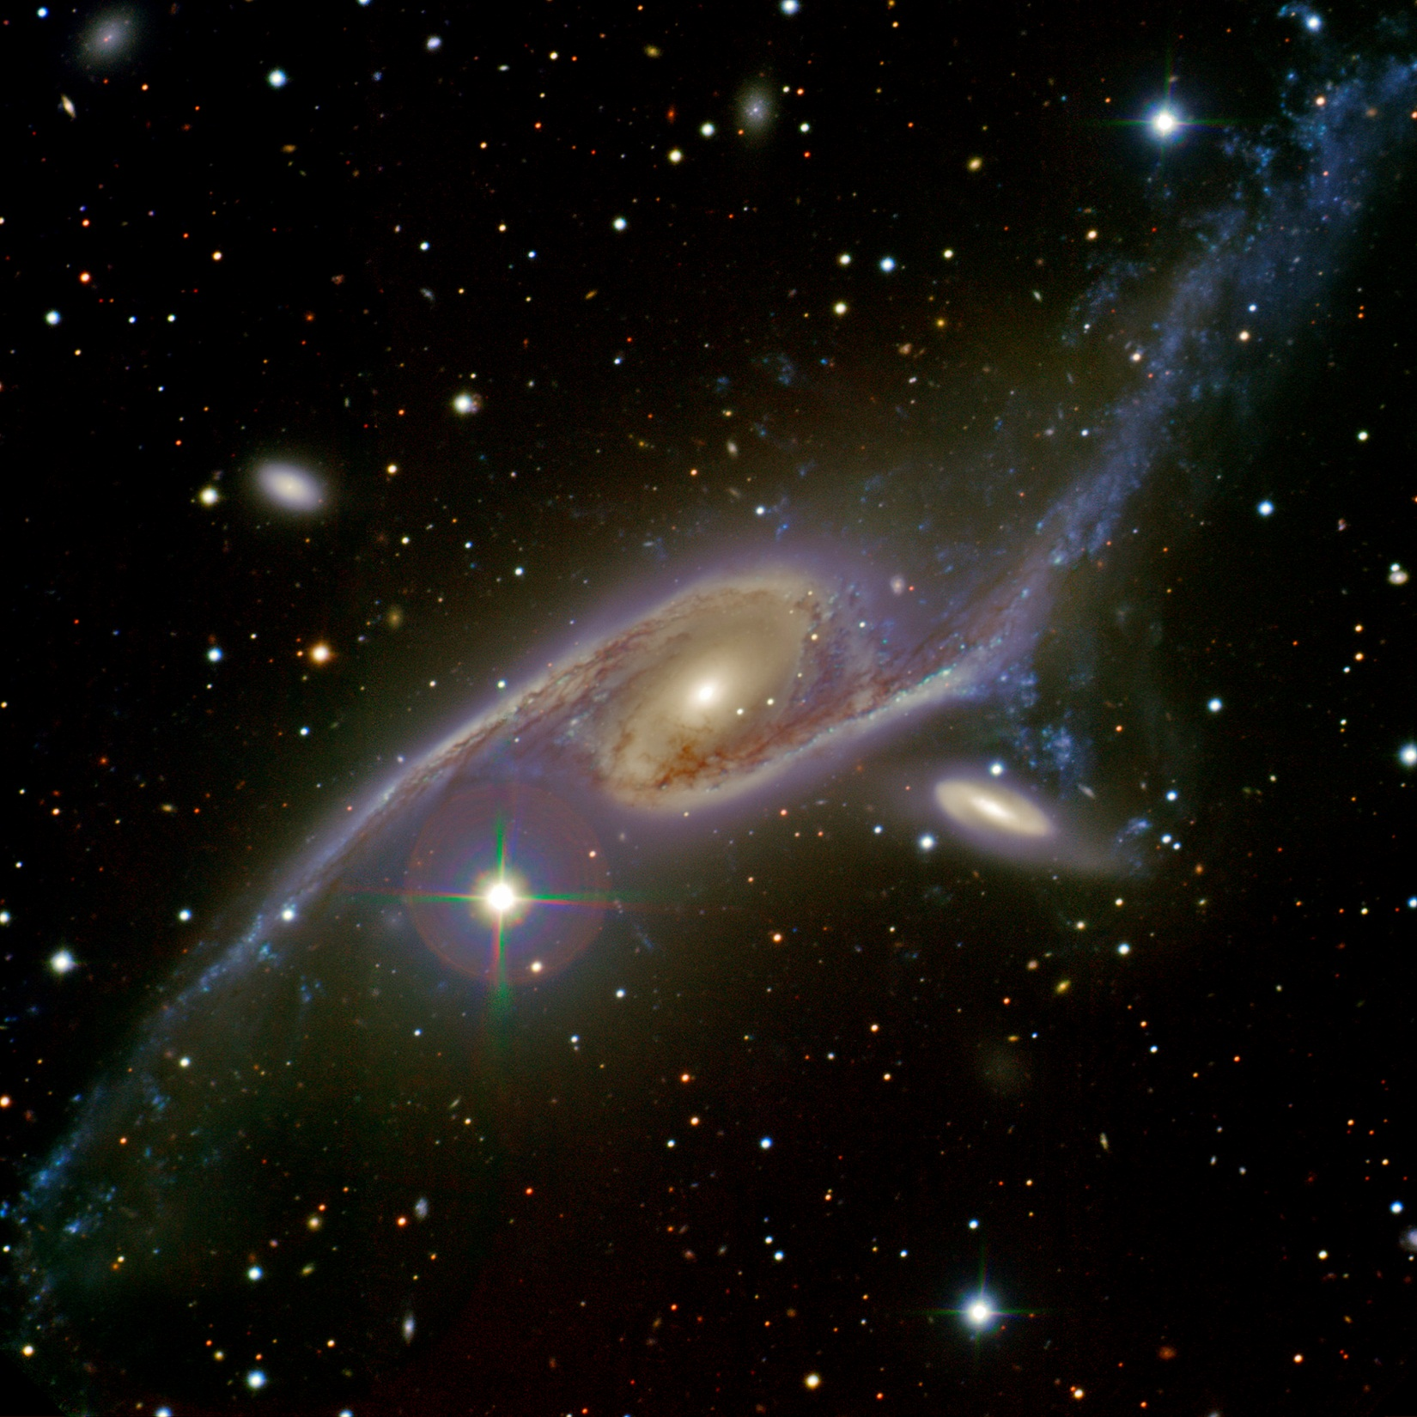
Wide-Field Science Capabilities at the AAO
Stuart Ryder
Australian Gemini Office
Australian Astronomical Observatory

Slide 2
Outline
Radio – Optical synergies
ATAC “open skies” access to
(UKST)
AAT
Gemini
Magellan
Time exchange
Complementing ASKAP Surveys

Slide 3
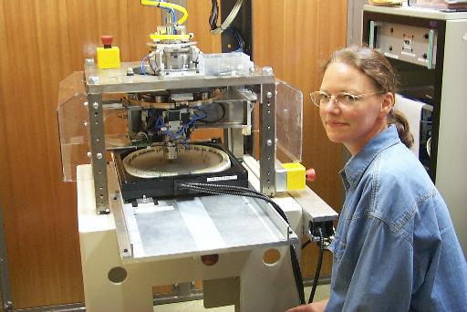
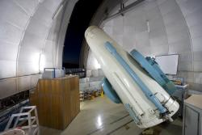
UKST
United Kingdom Schmidt Telescope
1.2m aperture, >6° FoV.
1973 – 2005: photographic surveys
2001 – 2012: 6dF multi-object spectroscopy (6dFGS, RAVE)
“User pays” operation
TAIPAN: spectroscopic survey of ~500,000 galaxies to r <17.5 (cf. SDSS) via refurbished/replacement positioner & spectrograph.
Excellent complement to WALLABY and EMU.
Collaborators/benefactors welcome! Contact Andrew Hopkins (ahopkins@aao.gov.au).

Slide 4
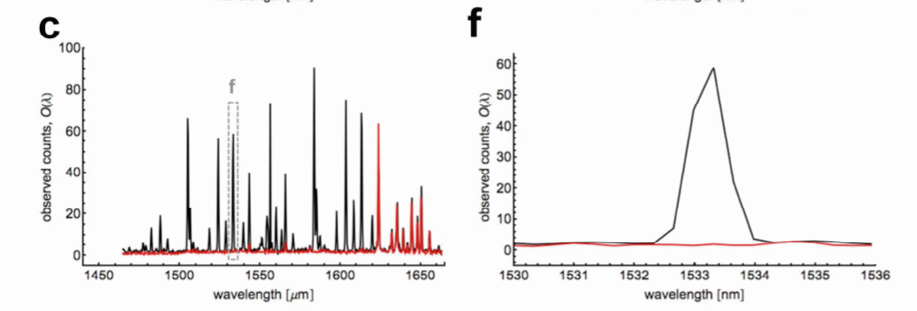
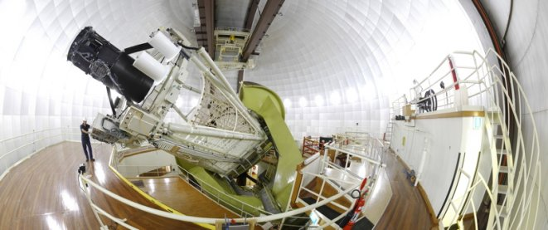
Anglo-Australian Telescope
3.9m aperture, commissioned 1975.
UCLES/UHRF R>40,000 optical spectrographs.
IRIS2 1–2.5 μm imager, R~2400 long-slit & multi-object spectrograph, 7'.7 FoV.
GNOSIS OH-suppression fibre-feed for IRIS2.

Slide 5
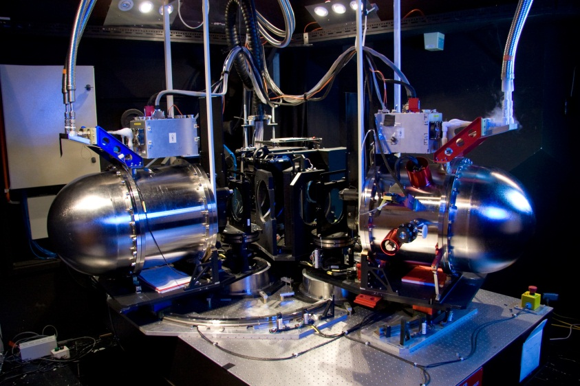
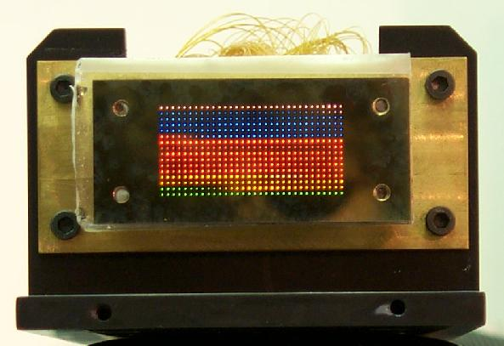
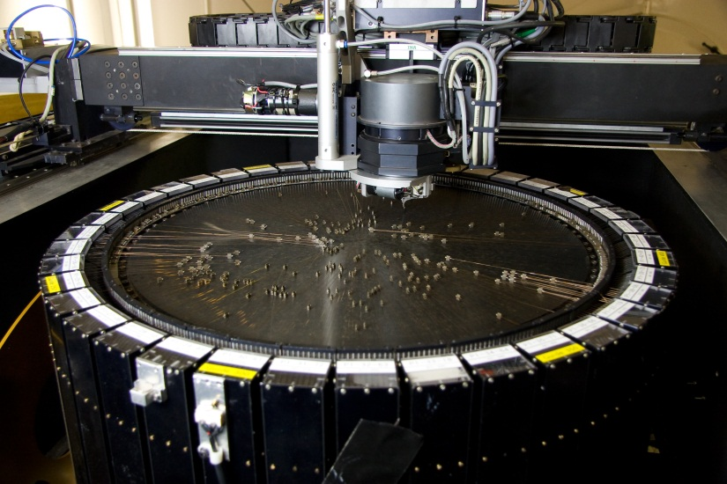
AAOmega
Dual-beam spectrograph, R=1300–8000, VPH gratings.
2dF robotic fibre positioner places 392 2" fibres within a 2° FoV (2dFGRS, 2QZ, WiggleZ, GAMA).
SPIRAL Integral Field Unit lenslet array covers FoV 22.4" × 11.2" at 0.7" per lenslet.
KOALA (2012/13) will double the SPIRAL FoV.

Slide 6
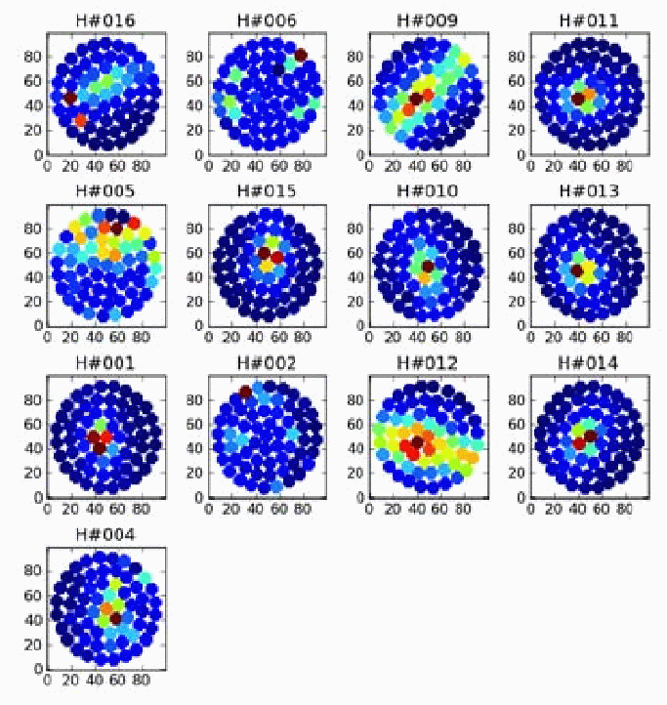
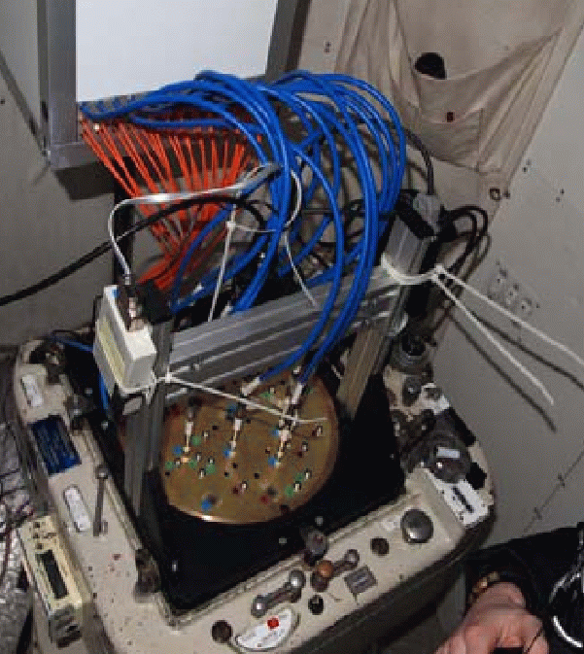
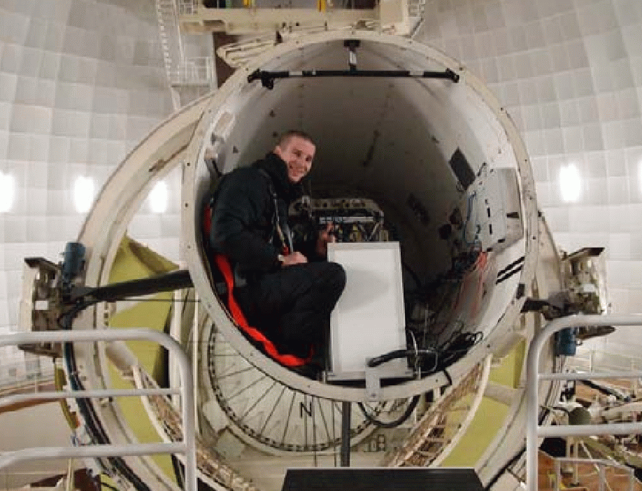
SAMI
Sydney-AAO Multi-object IFS
13 “hexabundles” of 61 lightly-fused fibres covering 14" at 1.6" per fibre, manually plugged into pre-drilled plates covering 1° FoV.

Slide 7
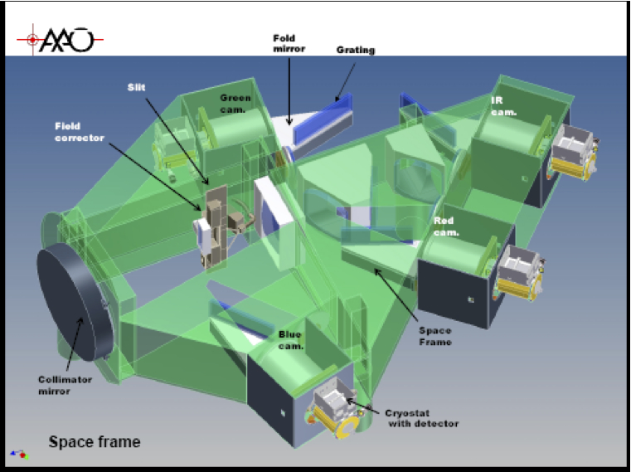
HERMES
R=28,000 in 4 channels centered on 478, 577, 661, and 774 nm; fed by 2dF.
S/N = 100 in 1 hr for V=14.
“Galactic Archaeology”: chemical tagging to reconstruct assembly history of Milky Way.
Optics fabricated by KiwiStar Optics.
Commissioning early-2013.

Slide 8
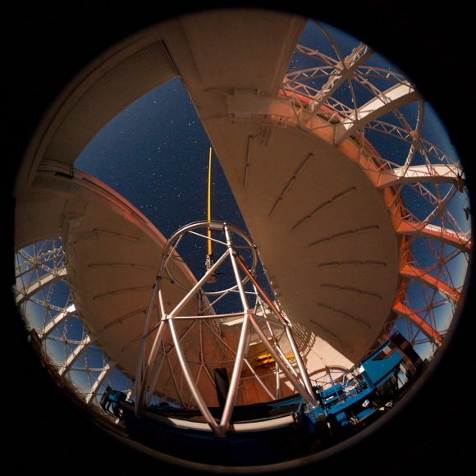
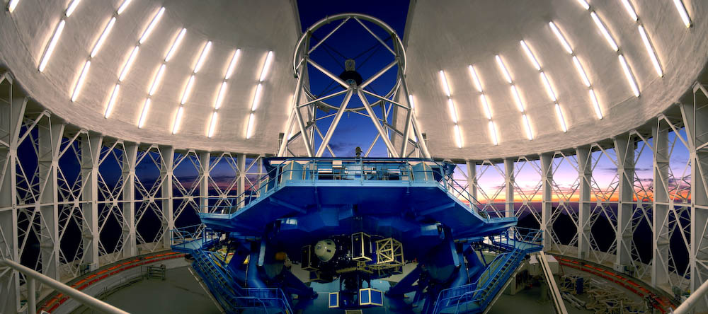
Gemini
2 × 8.1 m diameter infrared-optimised telescopes on Cerro Pachon (Chile) and Mauna Kea (Hawaii).
Cassegrain foci only.
~90% queue-scheduled observing, ~25% ToO.
Australia has 6.2% share in partnership with USA, UK (till end 2012), Canada, Argentina, Brazil, and Chile.

Slide 9
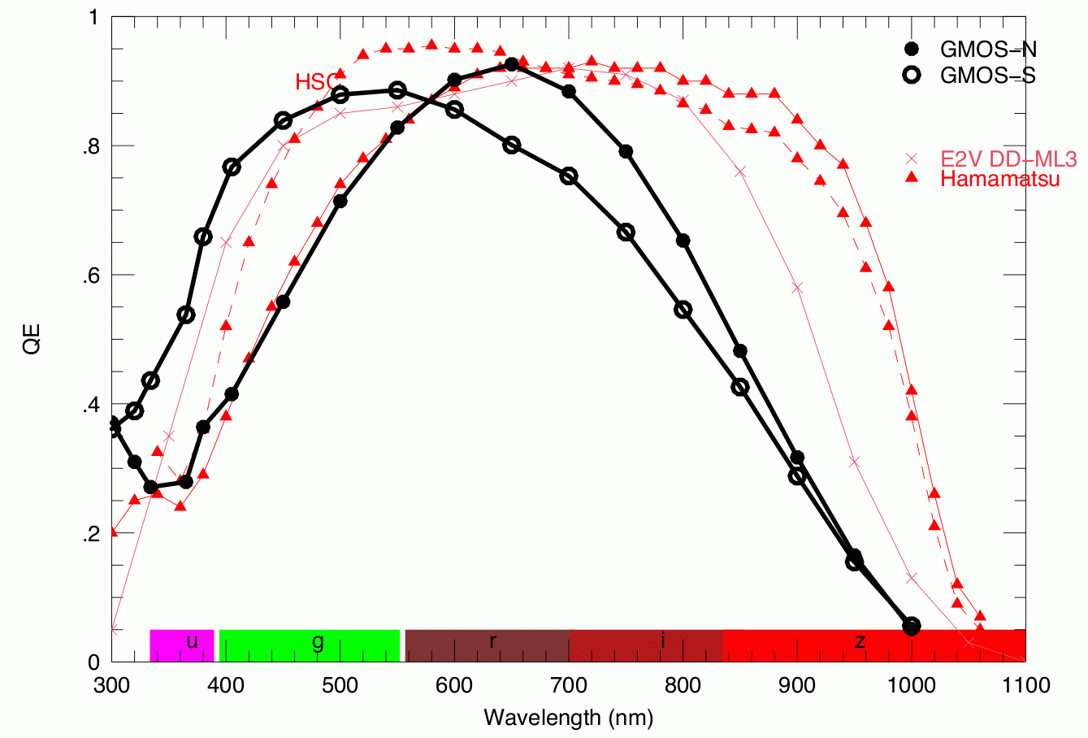
Gemini North
Reaches Dec −37°.
GMOS: 0.36–0.94 μm 5'.5 FoV imager, long-slit, multi-object, and IFU (5" × 7") spectrograph.

Slide 10
Gemini North
Reaches Dec −37°.
GMOS: 0.36–0.94 μm 5'.5 FoV imager, long-slit, multi-object, and IFU (5" × 7") spectrograph.
Michelle: 10–20 μm imager/spectrograph.
GNIRS: 1–5 μm long-slit and 0.9–2.5 μm cross-dispersed spectrograph.
NIRI: 1–5 μm imager with 22", 51", or 120" FoV.
NIFS: R=5000 1–2.4 μm integral field spectrograph with 3" FoV.

Slide 11
Gemini North
Reaches Dec −37°.
GMOS: 0.36–0.94 μm 5'.5 FoV imager, long-slit, multi-object, and IFU (5" × 7") spectrograph.
Michelle: 10–20 μm imager/spectrograph.
GNIRS: 1–5 μm long-slit and 0.9–2.5 μm cross-dispersed spectrograph.
NIRI: 1–5 μm imager with 22", 51", or 120" FoV.
NIFS: R=5000 1–2.4 μm integral field spectrograph with 3" FoV.
ALTAIR: Natural or Laser guide star adaptive optics system, delivering FWHM <0".1 at 2 μm.

Slide 12
Gemini South
GMOS: 0.36–0.94 μm 5'.5 FoV imager, long-slit, multi-object, and IFU (5" × 7") spectrograph.
T-ReCS: 8–26 μm imager and spectrograph.
NICI: 1–5 μm coronagraphic dual-channel adaptive optics imager, 18" FoV.
FLAMINGOS-2: 0.95–2.4 μm imager, long-slit, and multi-object R=1200–3000 spectrograph, 6'.1 FoV.
GSAOI: 0.9–2.4 μm imager, 85" FoV.

Slide 13
Gemini South
GMOS: 0.36–0.94 μm 5'.5 FoV imager, long-slit, multi-object, and IFU (5" × 7") spectrograph.
T-ReCS: 8–26 μm imager and spectrograph.
NICI: 1–5 μm coronagraphic dual-channel adaptive optics imager, 18" FoV.
FLAMINGOS-2: 0.95–2.4 μm imager, long-slit, and multi-object R=1200–3000 spectrograph, 6'.1 FoV.
GSAOI: 0.9–2.4 μm imager, 85" FoV.
GeMS: Multi-Conjugate Adaptive Optics, 5 × 10 W laser guide star constellation.

Slide 14
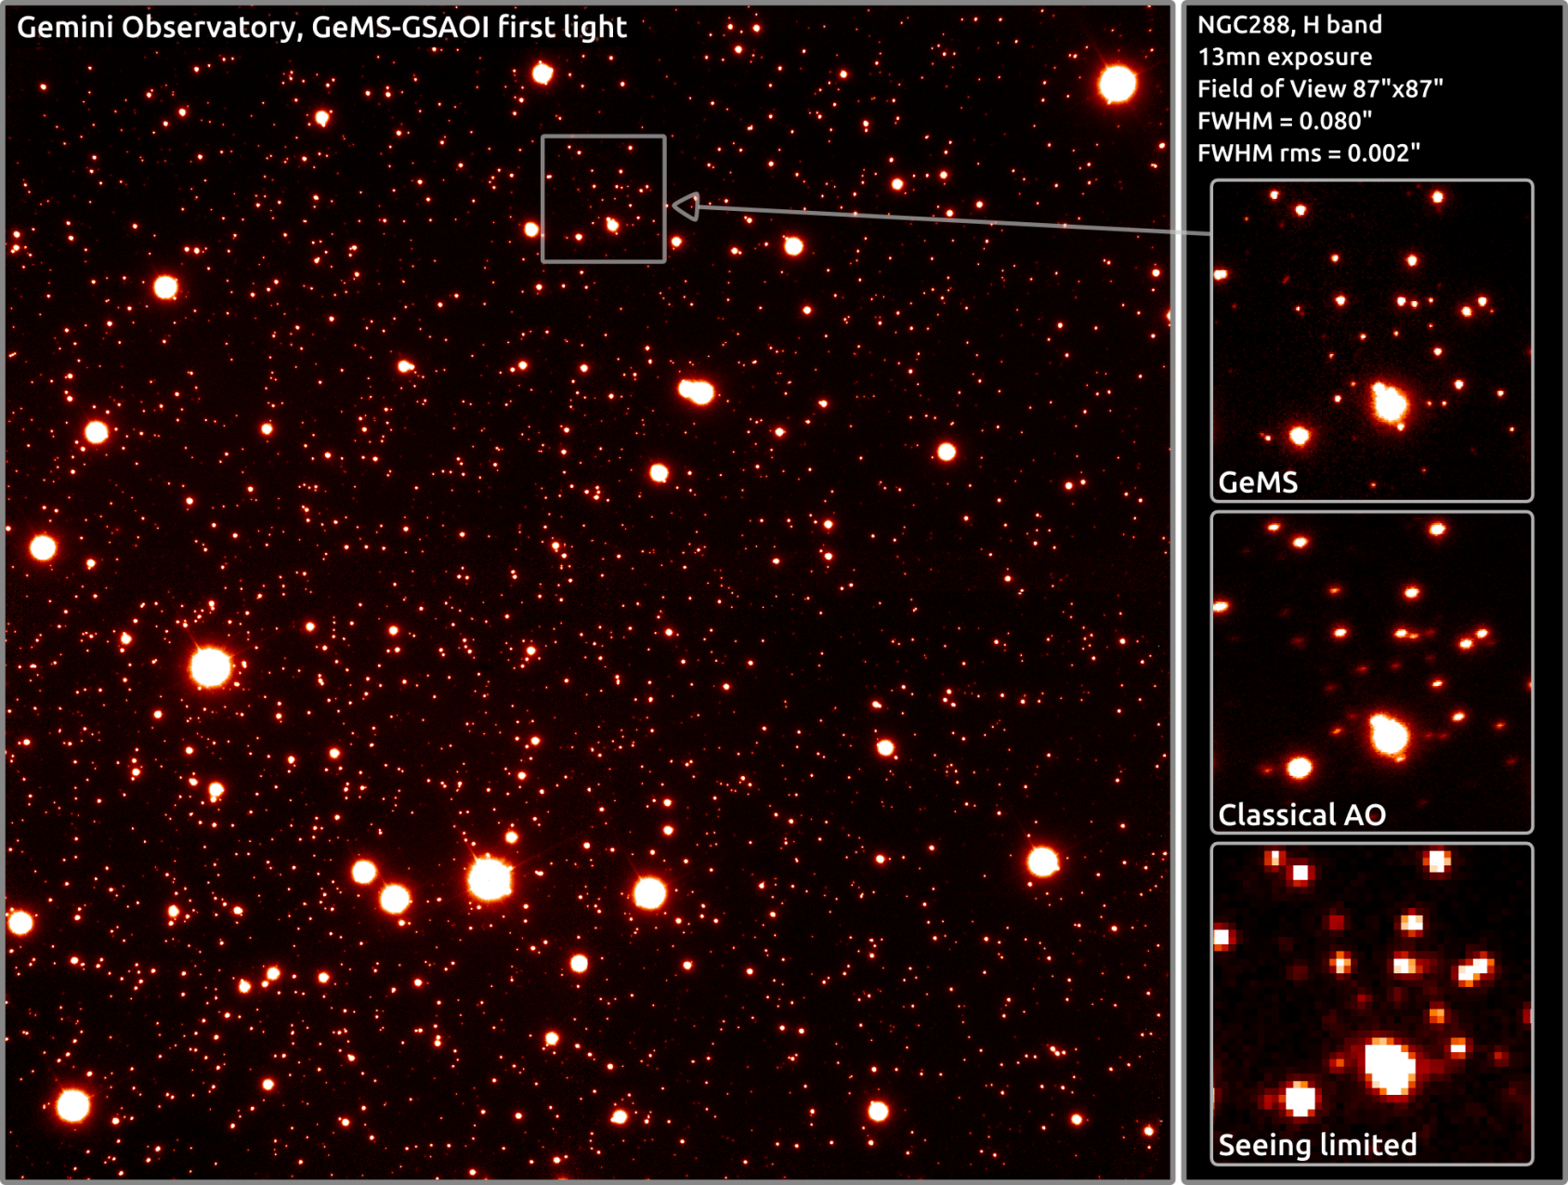
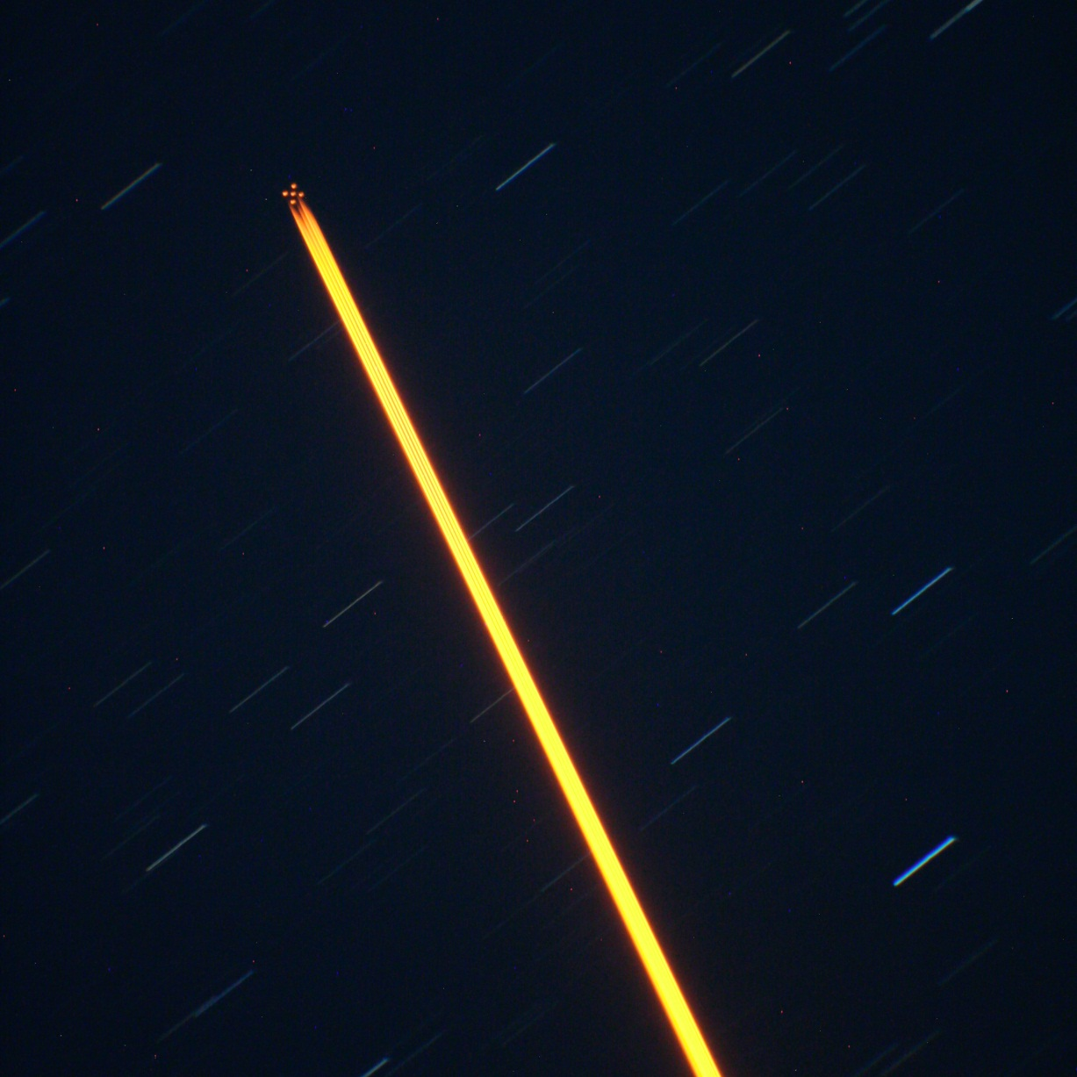
GeMS in action

Slide 15
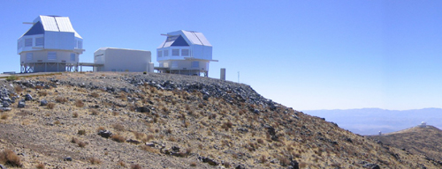
Magellan
2 × 6.5m telescopes at Las Campanas Observatory, Chile.
Australia purchases 15 nights per year from Carnegie Institution for Science.
MIKE: 0.34–0.95 mm R>20,000 spectrograph.
IMACS: optical imager, long-slit, MOS, IFU, and tunable filter spectrograph, FoV up to 27'.
FourStar: 0.9–2.4 μm imager, 11' FoV.
Megacam: optical CCD mosaic 25' FoV.
MMIRS: 1–2.4 mm imager, long-slit, and multi-object R=1500/2800 spectrograph, 6'.9 FoV.
MagE, FIRE, PFS.

Slide 16
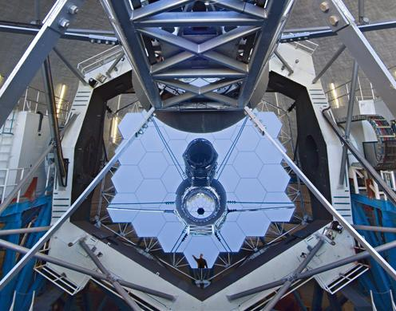
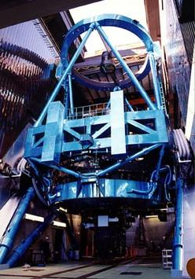
Time exchange
Gemini time exchange with Keck (5n/semester, HIRES 0.3–1.0 μm R>25,000 spectrograph only) and Subaru (up to 10n/semester) on any of:
FMOS: 0.9–1.8 μm spectrograph, 400 fibre positioner, 30' FoV.
Suprime-Cam: optical CCD mosaic, 34' × 27 ' FoV.
MOIRCS: 0.9 – 2.5 mm imager, long-slit, and multi-object R=500–3000 spectrograph, 4' × 7' FoV.
COMICS, HDS, IRCS

Slide 17
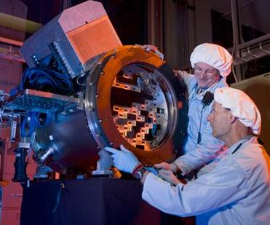
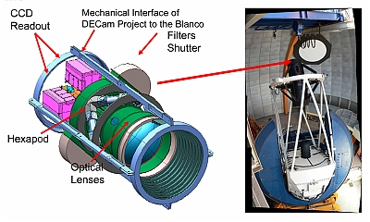
Time exchange
AAO and CTIO have agreed to swap 20 nights/year each on the AAT and Blanco 4 m telescopes from 2012B.
ISPI: 1–2.4 μm imager, 10' FoV.
Hydra: 0.32–0.9 μm R<50,000 138 × 2" multi-object fibre spectrograph, 40' FoV.
DECam: 62 CCD (570 Mpixel) mosaic, FoV 2.2° (!)

Slide 18
Meeting the Need
 | EMU | WALLABY | FLASH | VAST | GASKAP | POSSUM | CRAFT | DINGO | VLBI | COAST
2dF / Hydra / TAIPAN | ✓ | ✓ | ✓ |  | ✓ | ✓ |  | ✓
KOALA / SAMI | ✓ | ✓ | ✓ |  | ✓
HERMES |  |  | ✓ |  | ✓
GMOS / IMACS | ✓ | ✓ | ✓ | ✓ | ✓ | ✓ | ✓ | ✓ | ✓ | ✓
IRIS2 / F2 / 4Star / MMIRS / MOIRCS / ISPI | ✓ | ✓ |  | ✓ | ✓ | ✓ | ✓ | ✓ | ✓ | ✓
GeMS | ✓ |  | ✓ |  |  |  |  | ✓ | ✓ | ✓
Suprime-Cam / DECam / Megacam | ✓ | ✓ |  |  |  | ✓ | ✓ | ✓ | ✓ | ✓

