Slide 1
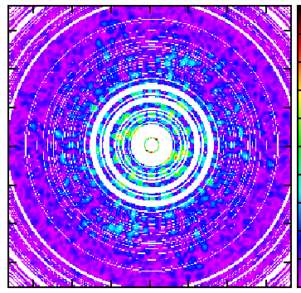
bayesian analysis of interferometric data (arXiv:1109.4640)
paul m. sutter
benjamin wandelt, siddarth malu
paris institute of astrophysics
university of illinois at urbana-champaign

Slide 2
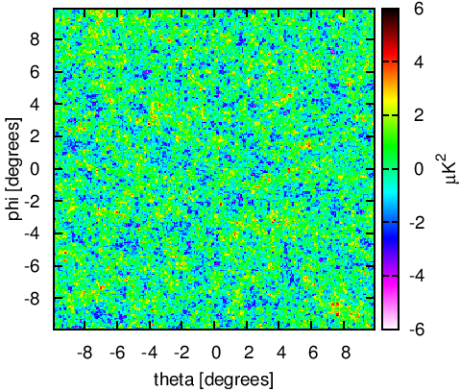
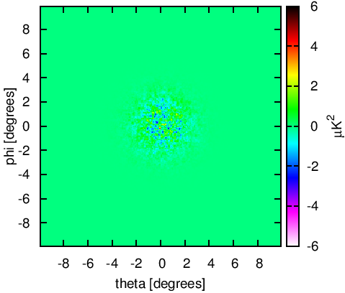
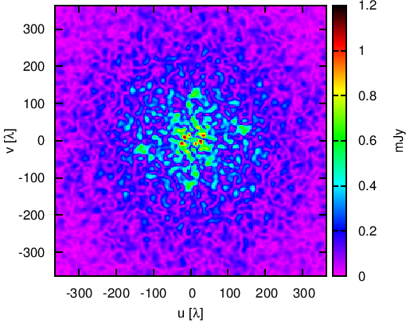
mock observations
signal
primary beam
uv-plane
data

Slide 3
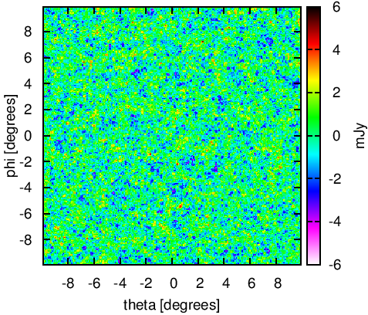
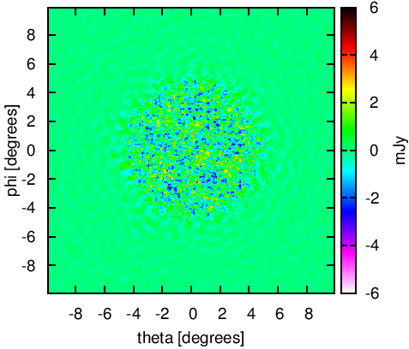
gibbs sampling
draw power spectrum realization
construct Wiener-filtered map
extract variance
add fluctuations consistent with noise and spectrum

Slide 4
advantages
fast and scalable – O(n_{p} log n_{p})
joint analysis of spectrum and signal
full exploration of uncertainties
automatically accounts for beam
free Wiener-filtered maps
trivial marginalization
straightforward foreground removal

Slide 5
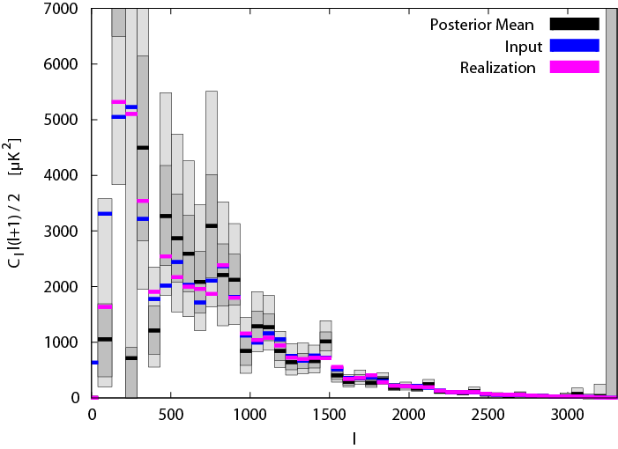
results – power spectrum

Slide 6
results - map
posterior mean
signal

Slide 7
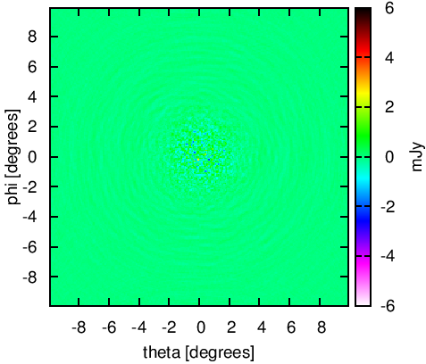
results - map
dirty map
posterior mean

Slide 8
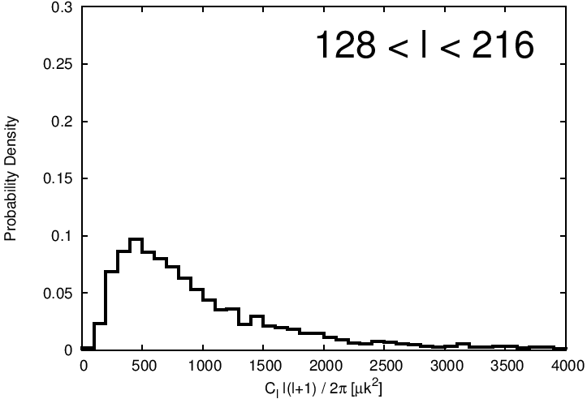
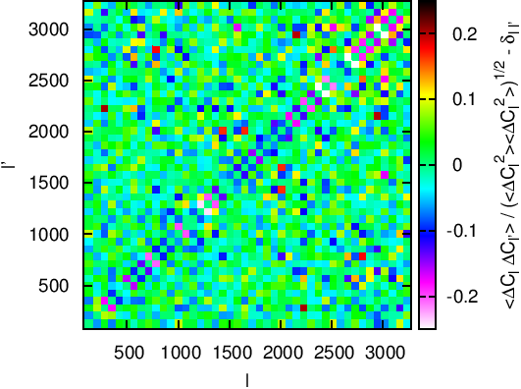
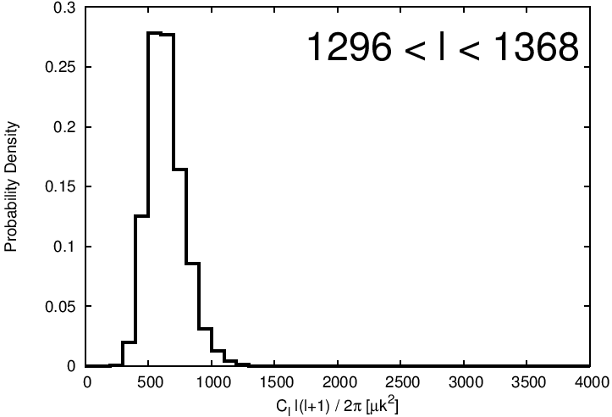
results – marginalized posteriors

Slide 9
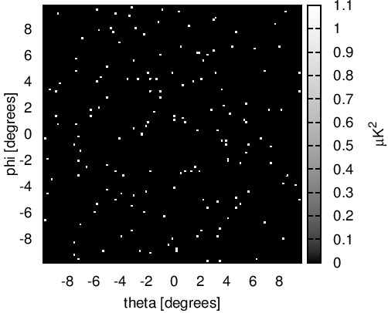
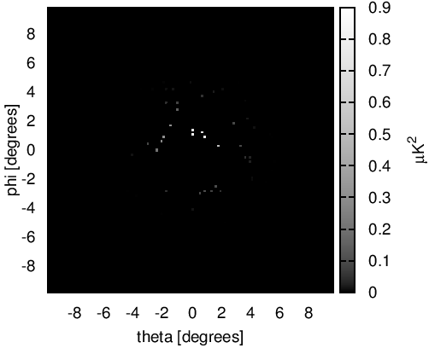
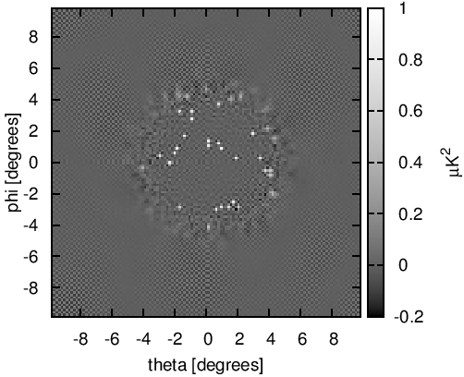
other applications
signal
primary beam
posterior mean

Slide 10
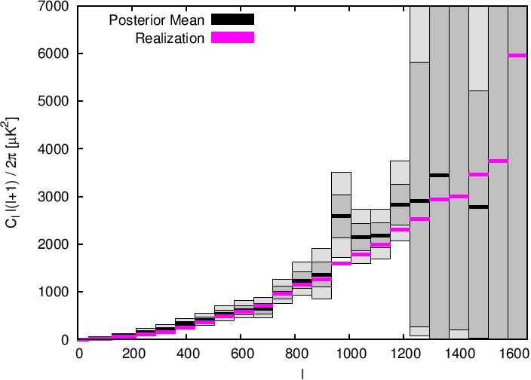
other applications

Slide 11
future work
multiple frequencies, polarization implemented
working on curved sky, foregrounds
developing point- and extended-source analysis
extending to 21 cm

